Slide 1
Autodesk BIM 360 - wybrane rozwiązania chmurowe Autodesk
Notes:
This presentation is designed to use as a companion piece to the BIM 360 Docs Sales Presentation. It includes a deeper look into the specific product features and contains screenshots. It can be used as a separate presentation, or the feature slides can be added into the associated – Publish, Share, View, Markup sections of the Sales Presentation.

Slide 2
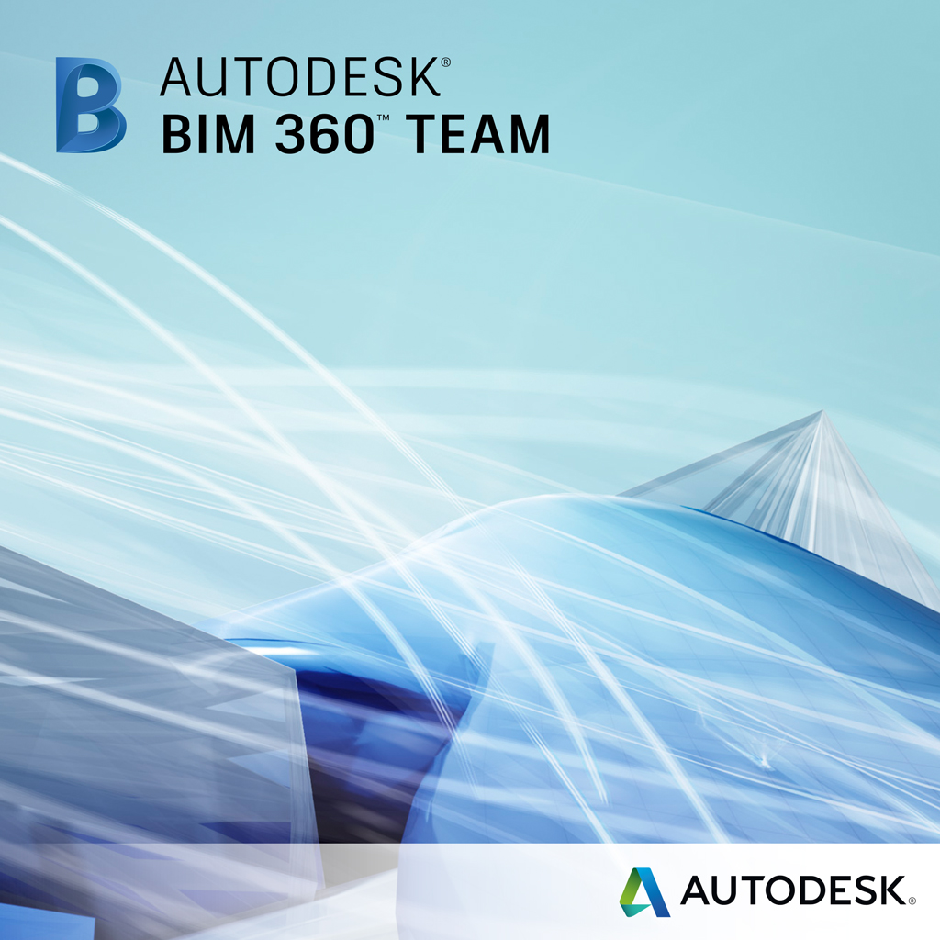





AGENDA:
Notes:
Here we are on the iPad, working in an offline or disconnected mode where you can work locally without the need to be connected to Wifi or Cell service to access the project data.
We simply browse the library of documents; select the folder needed, then select the drawing to view it.
An important feature of using BIM 360 Field is that you synchronize with the database and choose just the files you want/need in the field. This helps provide you with the right versions of the data at the right time

Slide 3
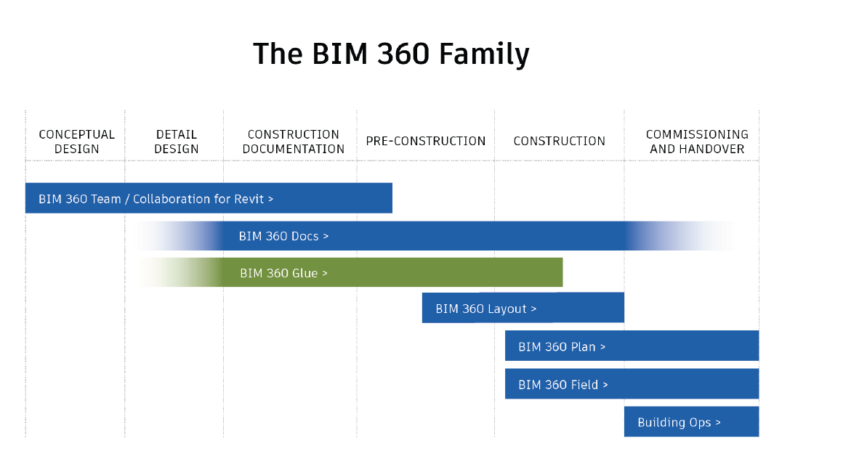

Slide 4
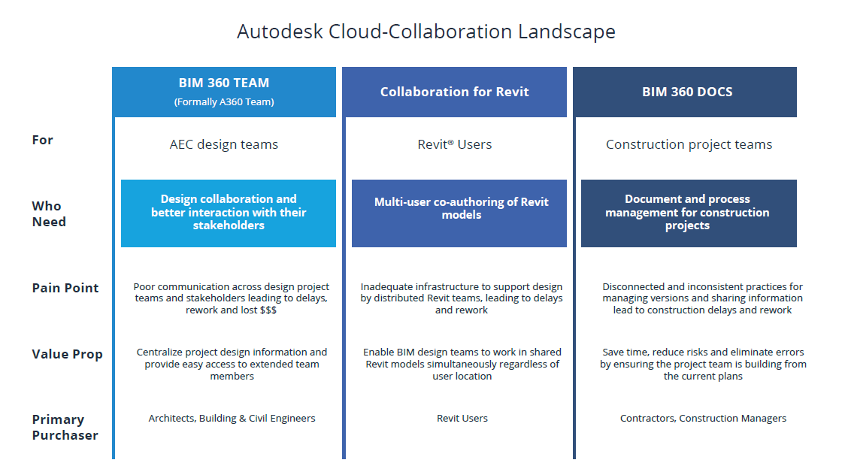

Slide 5
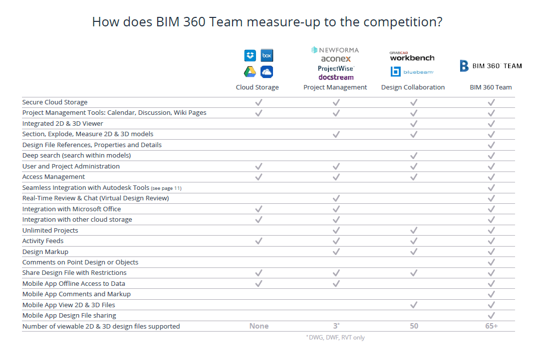
Notes:
Here we are on the iPad, working in an offline or disconnected mode where you can work locally without the need to be connected to Wifi or Cell service to access the project data.
We simply browse the library of documents; select the folder needed, then select the drawing to view it.
An important feature of using BIM 360 Field is that you synchronize with the database and choose just the files you want/need in the field. This helps provide you with the right versions of the data at the right time

Slide 6
BIM 360 TEAM
Autodesk Collaboration for Revit

Slide 7
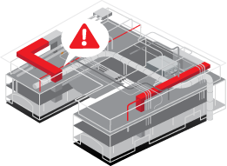
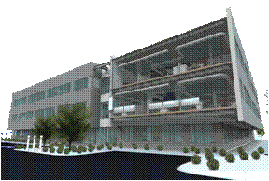

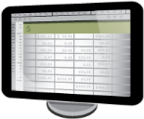
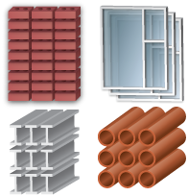
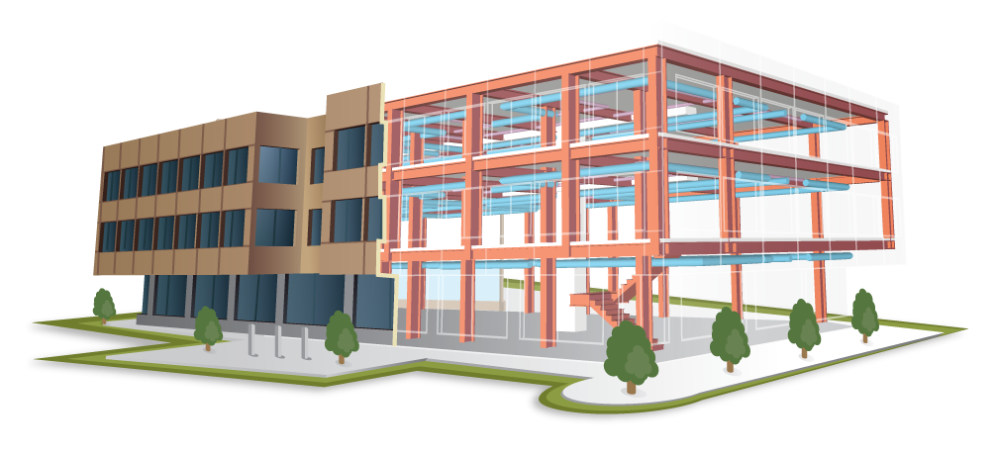
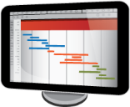
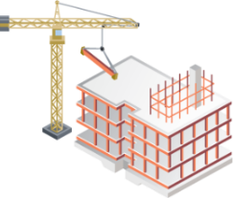
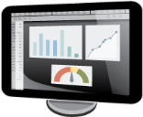
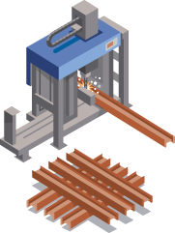
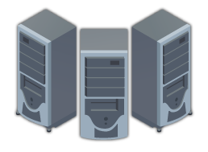
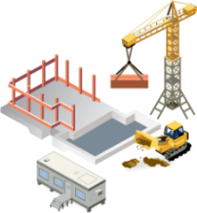
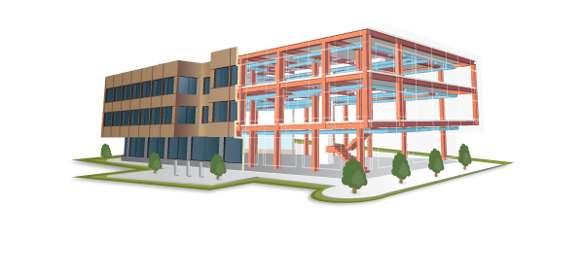
BIM
Koordynacja
Planowanie
inwestycji
Projektowanie
Szacowanie kosztów
BIM to przede
wszystkim
baza danych
Zestawienia
Harmonogram
Kontrola
projektu
Planowanie i logistyka
Bazy danych
Przekazanie
Fabrykacja
Planowanie budowy

Slide 8
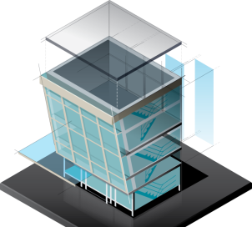









SCENARIUSZE PRACY
A360 Collaboration for Revit
Zespół
Pojedyncza lokalizacja
Wymiana plików
Zespół
Wiele lokalizacji
Revit Server
Wiele firm
Wiele lokalizacji

Slide 9
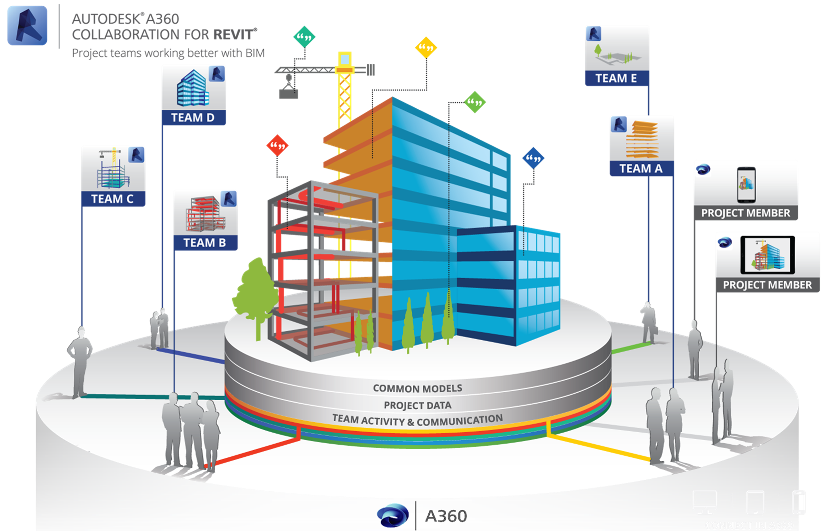
Dlaczego Autodesk A360 Collaboration for Revit?
Kluczowe korzyści:
Łatwy dostęp do danych projektowych
Usprawnienie komunikacji
Podłączenie całego zespołu projektowego
Notes:
So what is Autodesk Solution for better BIM Collaboration on Building Projects?
Autodesk® A360 Collaboration for Revit® is a Cloud Subscription service that works with Revit® software to connect building project teams with centralized access to BIM project data in the cloud.
With Autodesk A360 Collaboration for Revit, Project teams collaborating on AEC projects can simultaneously co-author models across companies or locations.
It enables direct access to project data across a firewall without a major IT investment.
It includes tools that enhance communication and better connect the entire project team, including those who need access to project models without installing Revit software or exporting to PDF.
Let’s talk about each one of these Key values in more detail, starting with Easy Access to Project Data.
Autodesk A360 Collaboration for Revit jest usługą Subskrypcja w Chmurze, która współpracuje z oprogramowaniem Revit do łączenia zespołów projektowych i wspólnej pracy na centralnym modelu
Umożliwia bezpośredni dostęp do danych projektowych w chmurze
Zawiera narzędzia, które usprawniają komunikację i lepsze połączenie całego zespołu projektowego, w tym tych, którzy potrzebują dostępu do modeli projektowych bez konieczności instalowania oprogramowania Revit lub eksportu do PDF.

Slide 10
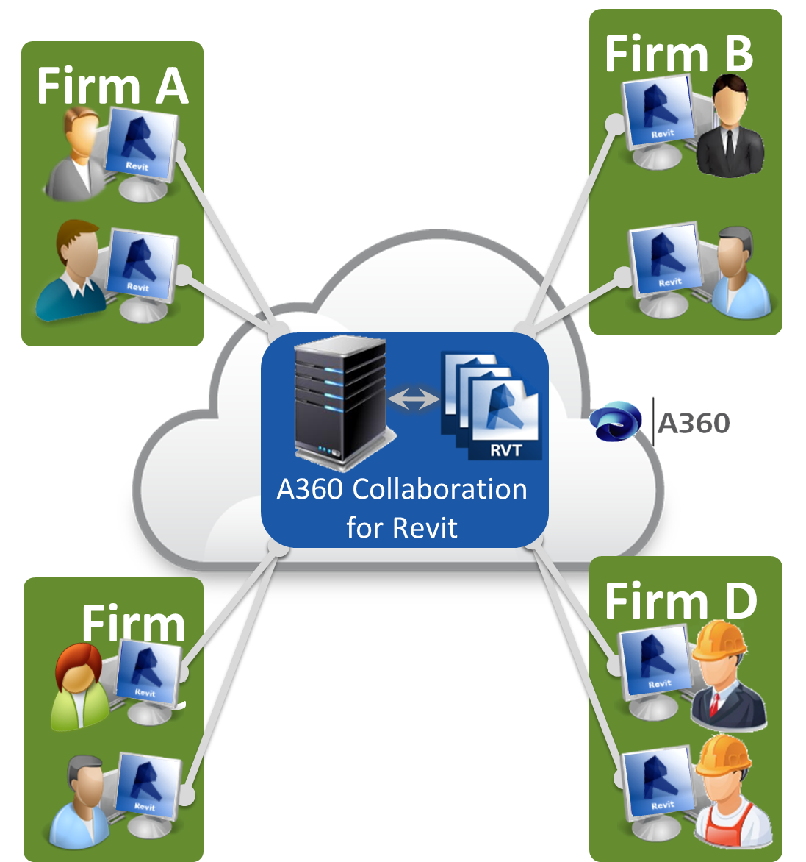
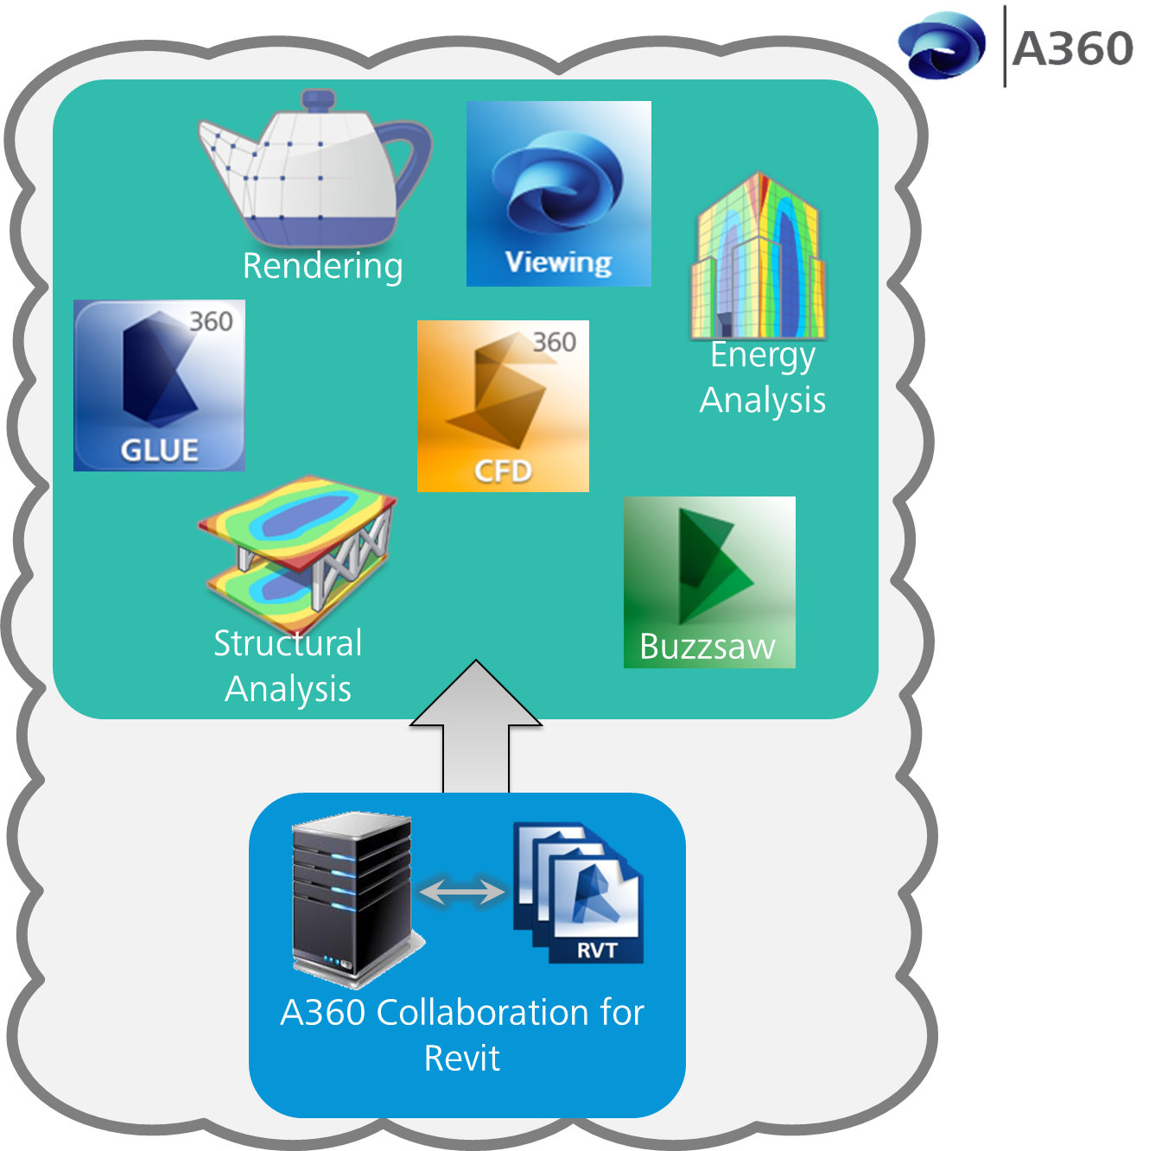

Praca współdzielona w chmurze:
Dostęp do danych projektowych:
Praca współdzielona wielu firm
Bez konieczności wsparcia IT
Bezpośredni dostęp do innych
usług w chmurze

Slide 11
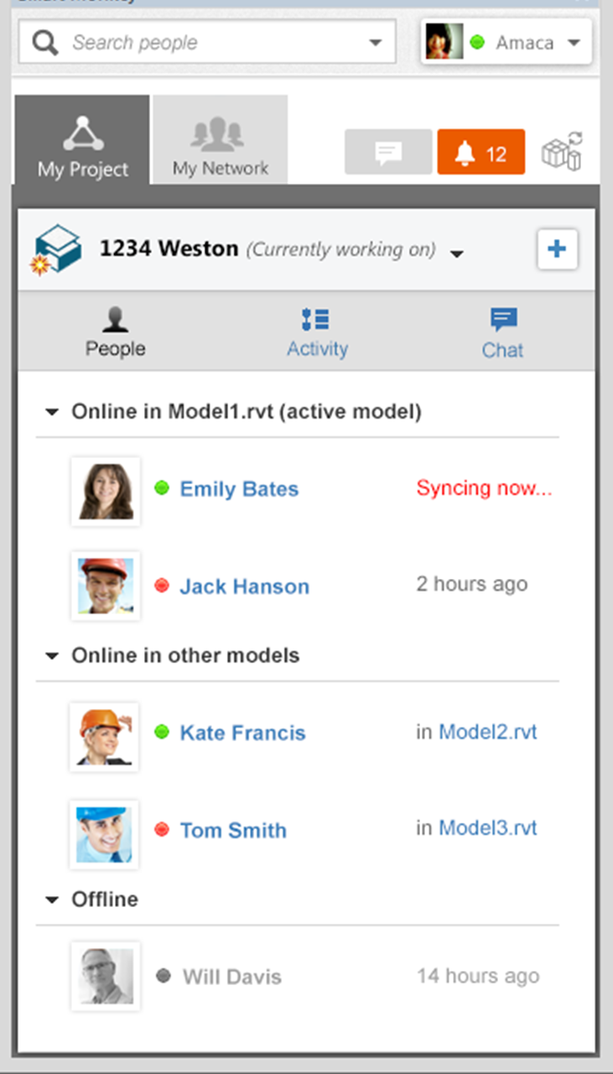
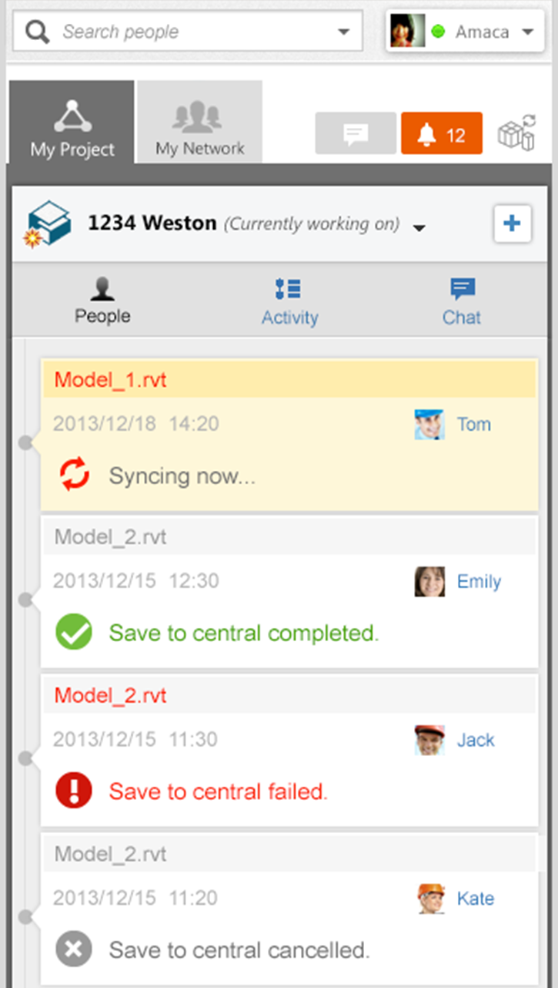



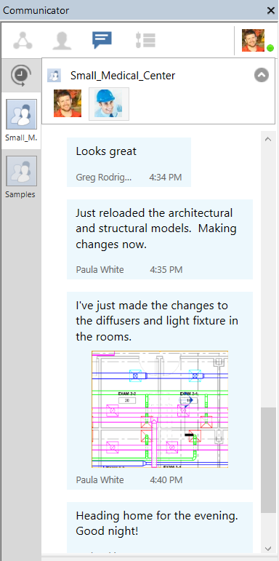
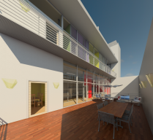



Praca współdzielona w chmurze:
Usprawnienie komunikacji:
Direct Chat
Komunikacja wielu firm
Historia zmian w projekcie
Śledzenie aktywności
uczestników projektu
Screen Shots
Team Chat

Slide 12

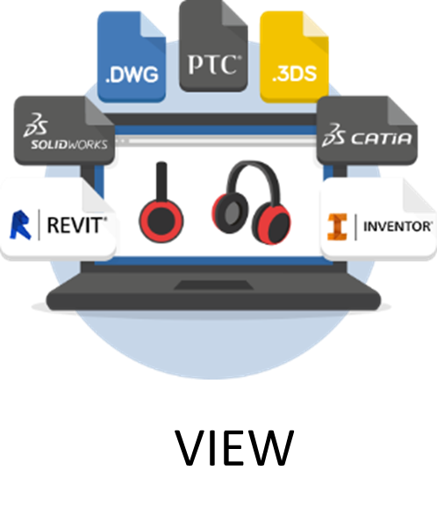

A360 TEAM:
Wspólna praca w jednym centralnym obszarze roboczym na A360
Dzielenie danych projektowych
Przeglądanie danych projektowych
Wyszukiwanie danych projektowych

Slide 13






A360 TEAM
Wspólna praca w jednym centralnym obszarze roboczym na A360
Łatwiejsza współpraca
Szybka wymiana informacji
Szereg funkcji dostępnych w chmurze
ARCHITEKT
KONSTRUKTOR
INSTALATOR
INŻYNIER
INWESTOR

Slide 14
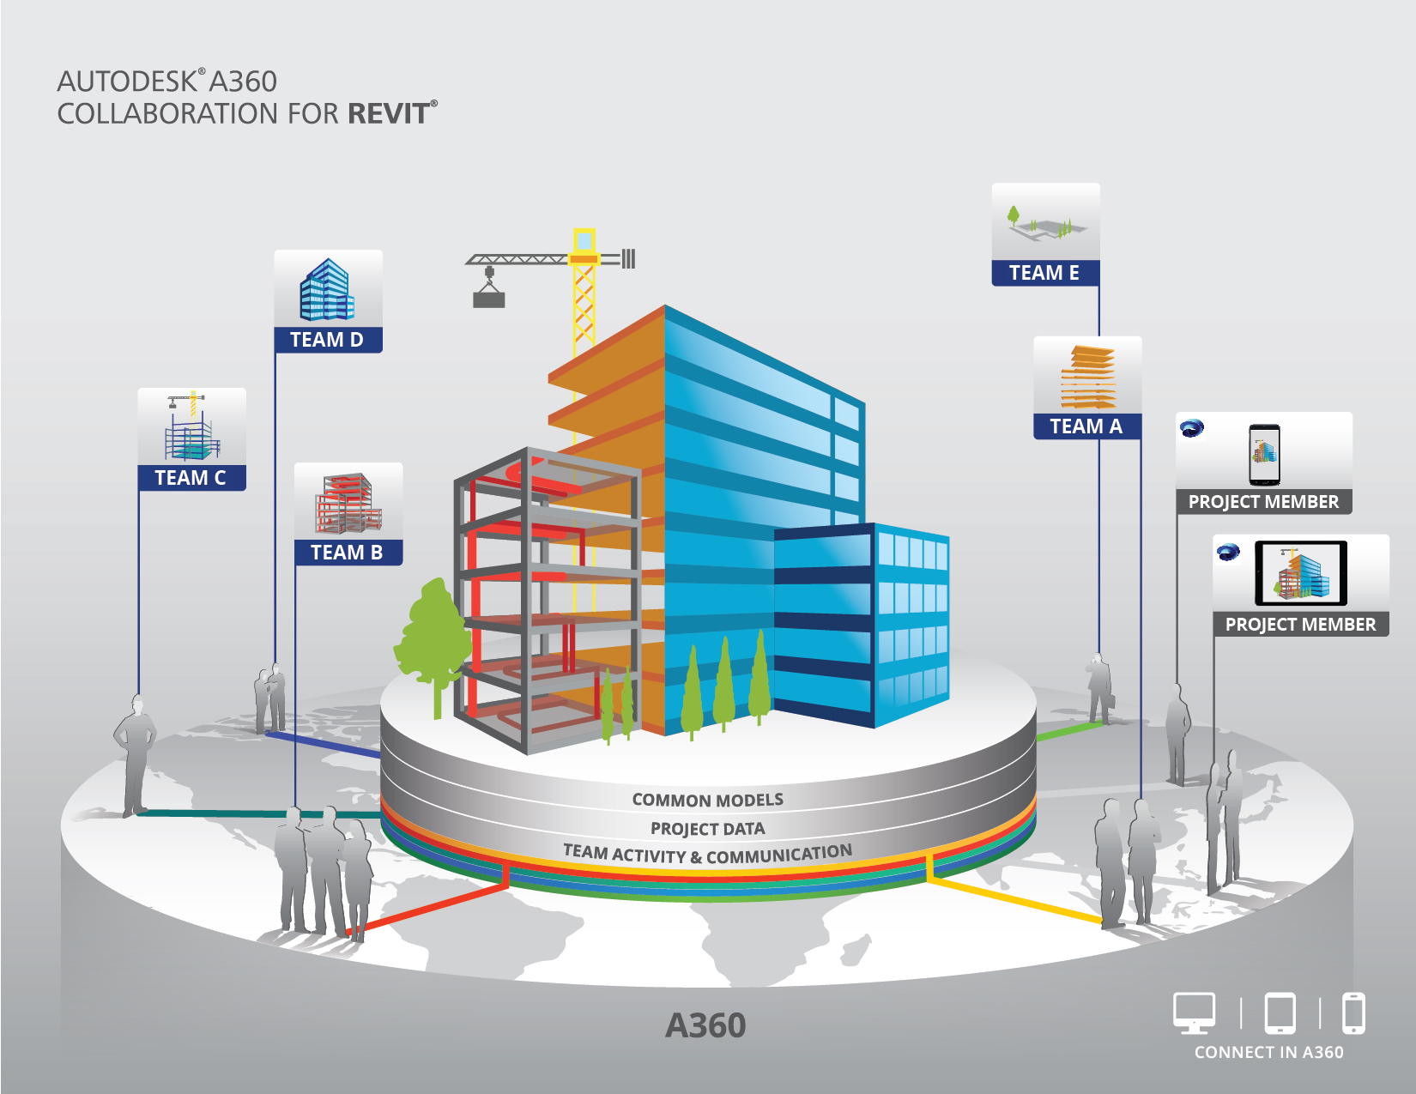
LICENCJONOWANIE
Użytkownik
Subskrypcja na:
  Miesiąc
  Kwartał
  1, 2 i 3 lata
Wszyscy członkowie zespołu potrzebują C4R
Każda licencja C4R zawiera BIM360 Team (10 GB przestrzeni)
Przykład: 20 użytkowników = 5 prod. C4R i 15 użytkowników BIM360 Team

Slide 15

Dostęp i subskrypcje
A360: Hub A
A360: Hub B
A360: Hub C
Projekt 1
Companies A+B
Projekt 2
Companies B+C
Projekt 3
Company
C + …
Firma A
Subskrypcje: 2 x C4R + 1 x BIM 360 Team
Firma B
Subskrybcje : 3 x C4R
Firma C
Subskrypcje : 1 C4R
Firma D (Inwestor)
Bezpłatny dostęp

Slide 17
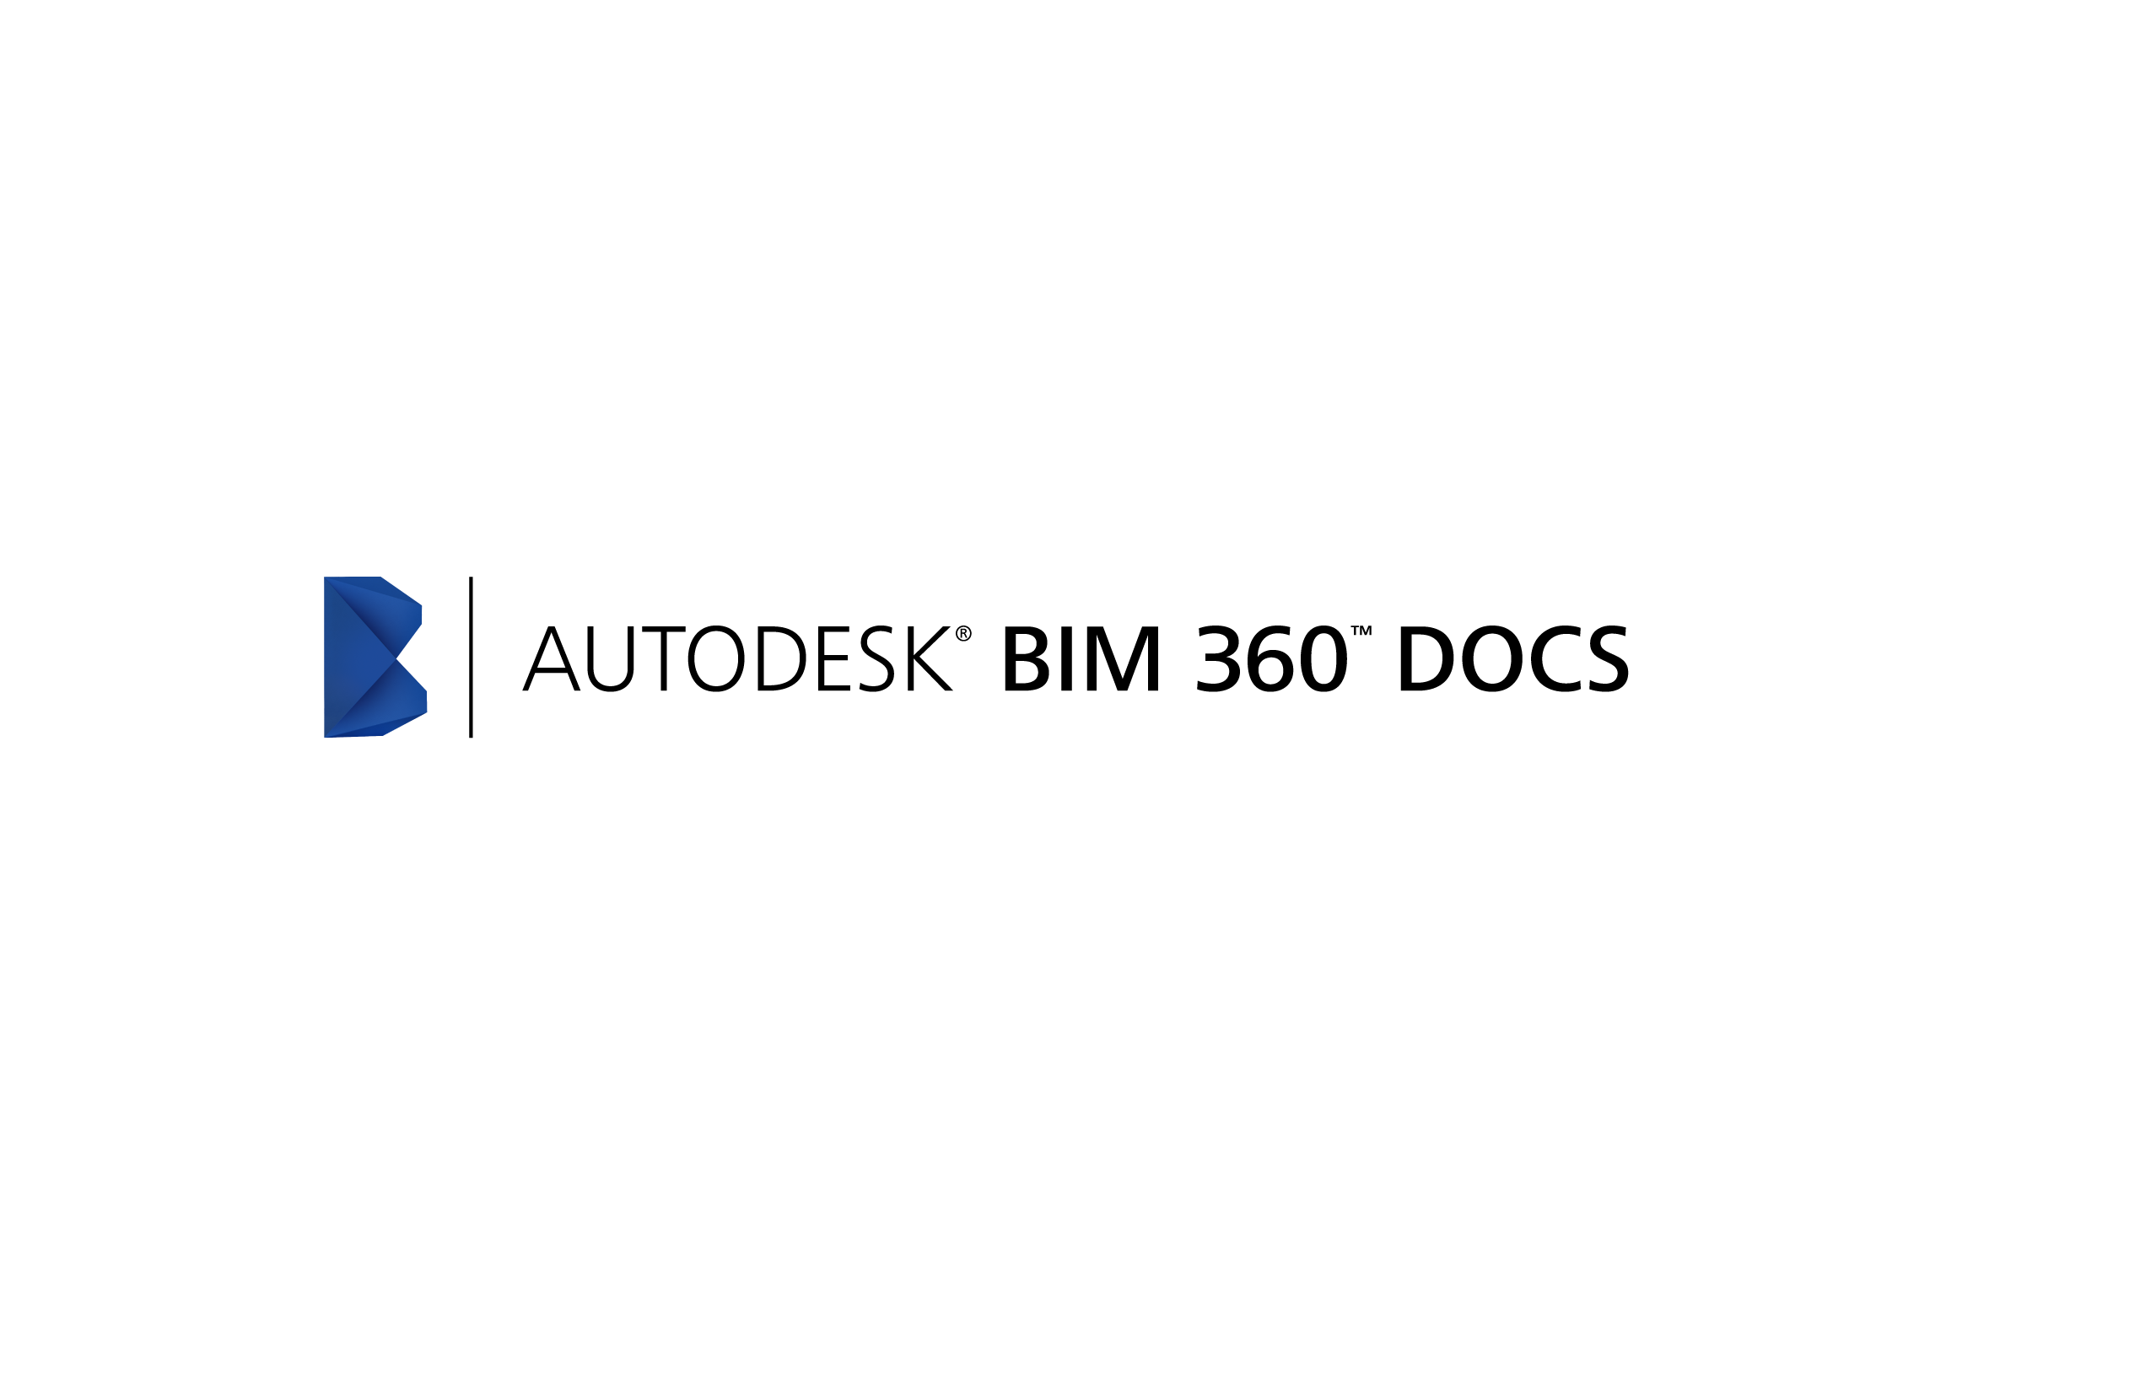

Notes:
Autodesk BIM 360 Docs has been built to solve the document management problems faced by the construction industry. It helps to ensure that the entire construction project team is building from the correct version of documents and plans. Tailored for the needs of the AEC industry, BIM 360 Docs delivers tools for publishing, managing, reviewing, and approving all project plans, models and documents from the earliest phase of a project through owner occupancy. A cloud-based service, accessible at the desktop or mobile devices, BIM 360 Docs delivers anywhere, anytime collaborative access to the entire project team.

Slide 18
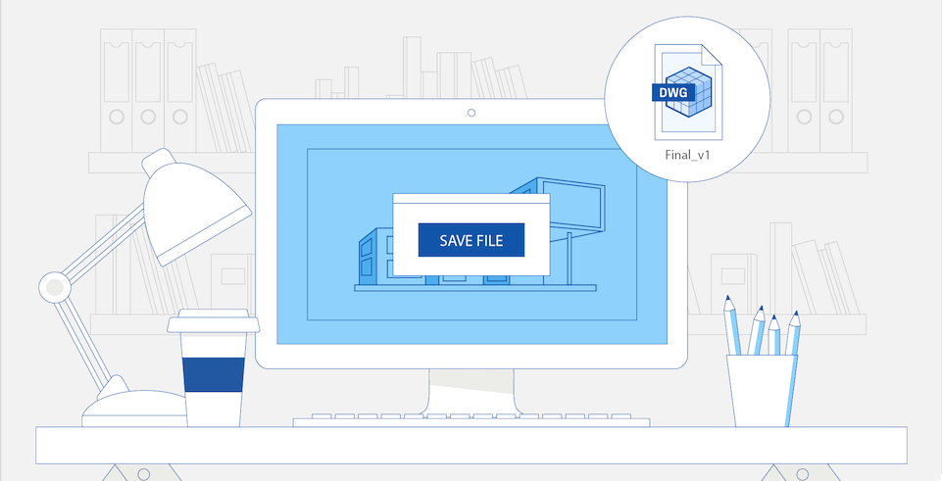
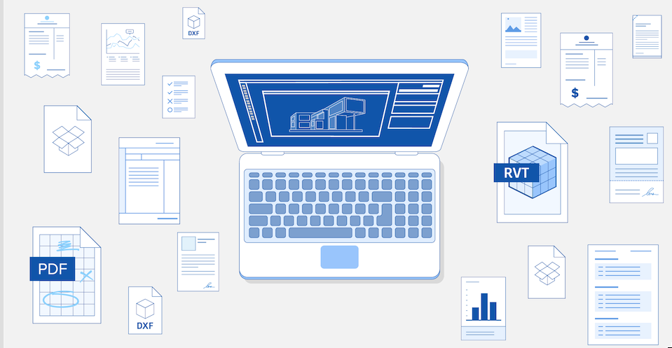
Zmiana sposobów kontroli dokumentacji
Duża ilość dokumentów i wersji
Wykorzystanie mobilnych technologii
Zgodność ze standardami
Notes:
Three factors are in play that are changing how document control is handled in today’s construction projects.
Overwhelming pressure to process volume of documents, manage versions and release accurate information to the field
Added complexity with adoption of BIM and requirement for sharing model-based design
Mobile technologies increase demand for instant access to latest available information
Versioning is happening in real-time; need for instant coordination
Compliance and legal requirements for single data repository for entire project
BIM Level 2/PAS 1192; other standards
Litigious nature of construction projects
The “Document Control Manager” is no longer a 1-person job; Document Control is now democratized requires a collaborative effort.

Slide 19


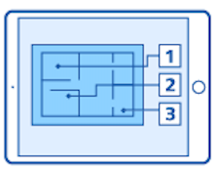
Technologie wykorzystywane obecnie
Współpraca oparta na chmurze
PDF
Aplikacje mobilne
Notes:
As Document Control has become more democratized and a collaborative effort, a number of technologies have emerged to help construction project teams maintain a single source of truth for project documents:
Cloud-based collaboration and file sharing tools provide anytime/anywhere access to digital documents – both in the office and in the field
PDF creation and editing software are utilized for markups, edits and merging/splitting of files
Field-based mobile apps reduce the time spent getting input from the field shared with the larger project team

Slide 20

Jak się odnaleźć w olbrzymiej ilości gromadzonych informacji?
Notes:
While there are benefits to each of these pieces of the construction technology stack, two significant problems can occur with this adoption of technology:
Information is caught in siloes
Applications have very specific purposes:
Cloud-based collaboration tools are built to share files across multiple parties
PDF editing tools are built to create and modify PDF drawings and documents
Field apps are built to manage photos, markup drawings and manage issues
And so on…plan viewers, model viewers, project administration tools, etc.
When documents, plans and models are accessed, modified and shared within an application, they remain in that application. Resulting in:
No single source of truth
Out of date versions
Incorrect communication to subs and trades
Many questions around what is current
Errors and re-work

Slide 21
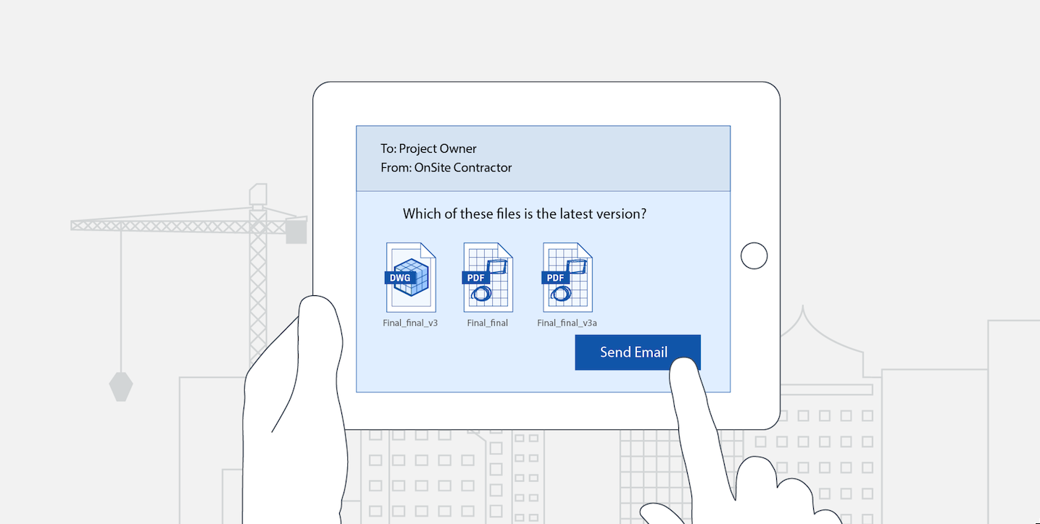
Która wersja pliku jest aktualna?
Notes:
Many problems on job sites – cost over-runs, delays and re-work – occur because project teams do not have access to the most current set of documents.

Slide 22
Notes:
Autodesk BIM 360 Docs has been built to solve these document management problems. It helps to ensure that the entire construction project team is building from the correct version of documents and plans. Tailored for the needs of the AEC industry, BIM 360 Docs delivers tools for publishing, managing, reviewing, and approving all project plans, models and documents from the earliest phase of a project through owner occupancy. A cloud-based service, accessible at the desktop or mobile devices, BIM 360 Docs delivers anywhere, anytime collaborative access to the entire project team.

Slide 23

BIM 360 DOC
ZAŁADUJ
WSPÓŁDZIEL
PRZEGLĄDAJ
ZAZNACZ
Notes:
BIM 360 Docs offers a host of capabilities across the four key areas of document management – publishing, sharing, viewing and modifying.
Provides industry-specific capabilities for managing all 2D plans, 3D models and other project documents:
Document registry with rationalized, automated naming and structuring
Role-based access control, version control and set linking
Support for approval processes and workflows
Highly integrated with Autodesk BIM 360 products
Seamlessly integrated with authoring apps and existing cloud and local file systems
Supports virtually all AEC 2D and 3D file and data formats in the cloud
Tightly integrated with Autodesk AutoCAD and Autodesk Revit
Federates data from other document management systems
Integrates with LAN/WAN with delta file transfer
Delivers anywhere, anytime collaborative access to the entire project team
Web and mobile access to all project plans, models and documents with no software download required
Collaborative viewing, markup and issue management
2D, 3D and data-driven project views
Issue reports and dashboards provide visibility into whole project issues
Ensures that all project teams are building from the correct document versions
Registry views provide visibility into version changes over the course of the project
Cloud repository and mobile access give all team members access to the correct set of data at all times
Set business rules for the release of data to the right parties with the correct markups
Give instructions “in-context” of work to be done through markup and issue management tools

Slide 24

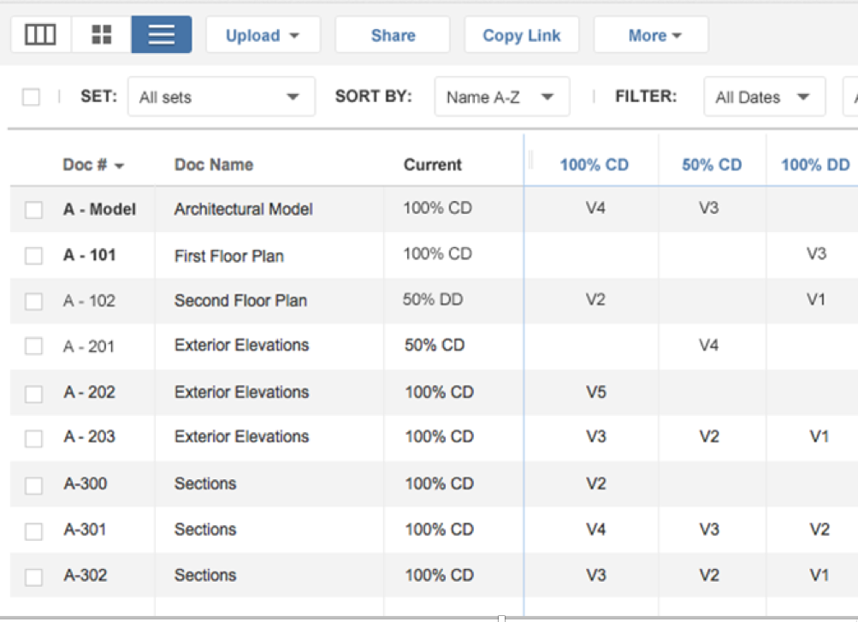
ZAŁADUJ
Notes:
BIM 360 Docs aids with the publishing of documents by automating common and repeatable tasks that occur throughout a project:
Automatic extraction of sheets from Revit models
OCR of title blocks to automate the naming process
Merging and separation of PDF sheets
Logical, construction-specific organization in a single repository

Slide 25

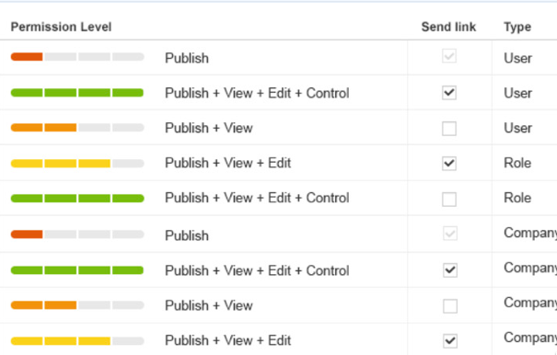
WSPÓŁDZIEL
Archiwum dokumentacji
Kontrola dostępu
Historia wersji
Notes:
BIM 360 Docs aids with the sharing of documents by ensuring the right people have access to the right information. It does this by:
Presenting information in a logical format, aligned with construction project phases and sets, including percent complete phases
Tracking & maintaining versions to allow quick navigation between versions, help identify changes, or roll-back to an earlier point in time
Control the release of information to the field through permissions and access rights
Flexibility to assign permissions at user, role or company level

Slide 26
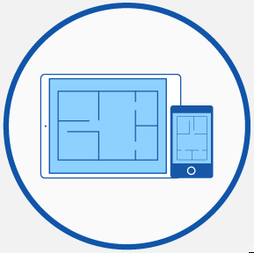
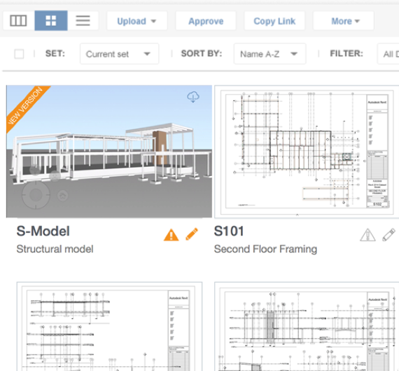
PRZEGLĄDAJ
Mobilny dostęp
Wyświetlanie 2D & 3D
Dostęp do właściwości obiektów
Notes:
BIM 360 Docs aids with the viewing of documents by offering powerful, fast viewing of 2D plans, 3D models and other file types in a single viewer.
Autodesk’s Large Model Viewer provides quick navigation between 2D and 3D documents in a single UI, optimized for viewing on mobile devices
Logical List, Thumbnail and Registry views make it easy to find the document you need
Access documents on the Web, iPhone and iPad – including offline sync for use in the field when Web access is not available
View object properties from 3D models

Slide 27

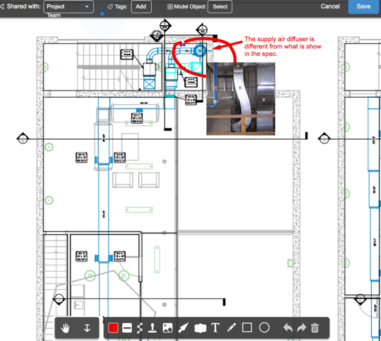
ZAZNACZ
Zaznaczanie
Zarządzanie problemami
Raporty
Notes:
BIM 360 Docs aids with the markup of documents by providing collaborative viewing, markup and issue management by:
2D and 3D markup tools, including thumbnail views of all markups for quick review and approval
Assign project issues “in context” to project members in the field
Providing visibility into whole project issues with reports and dashboards

Slide 28
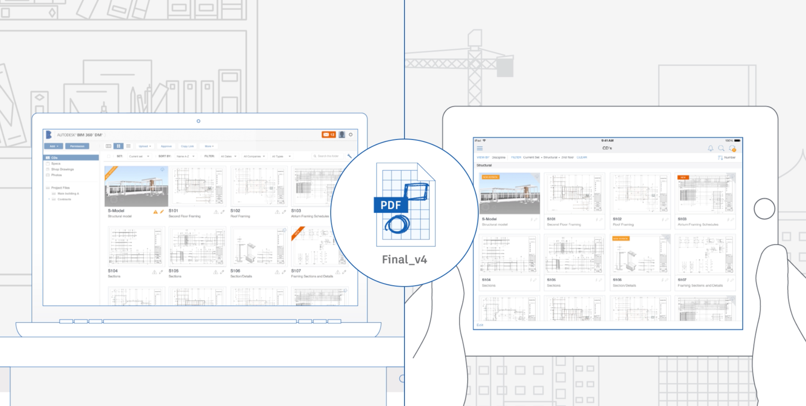
W biurze i w terenie dane zawsze zsynchronizowe
Notes:
The second primary differentiator is BIM 360 Docs ability to keep the office and field in sync – addressing the challenges of collecting, coordinating and communicating changes and versions.
During a project, data is shared, modified and shared again multiple times by design teams and contractors. Often, by the time the construction team is ready to offer pricing, data has been shared up to 12 times. Versions are created and for every version there can be thousands of sheets.
Version control is extremely important, particularly to protect against litigation. To keep versions up to date and move the project along, input is gathered and coordinated through every project team member. Giving anytime, anywhere access to documents and the tools to create and assemble markups –tightly controlled through permissions – helps to streamline this process.

Slide 29
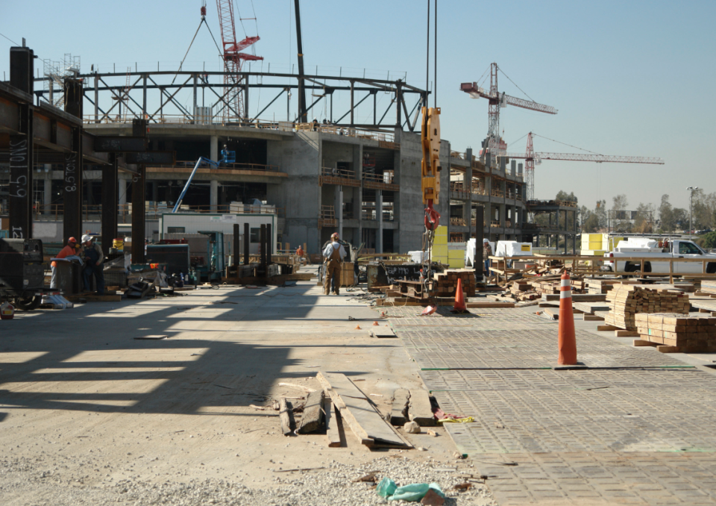


Pre-construction
Construction Execution
Commissioning/Handover
Notes:
As we have discussed previously Autodesk® BIM 360™ Glue is a cloud-based BIM management and collaboration product that connects the entire project team and streamlines BIM project workflows. With anywhere, anytime access to the most recent project models and data throughout the project lifecycle, BIM 360 Glue accelerates project reviews and empowers multidisciplinary teams to quickly identify and resolve coordination issues.
We will now go through a detailed demonstration of BIM 360 Glue to see how it does this.

Slide 30
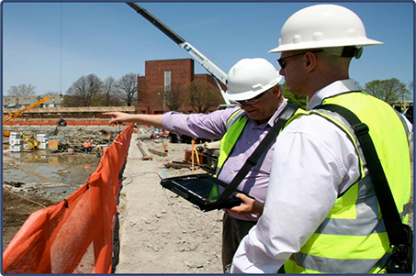
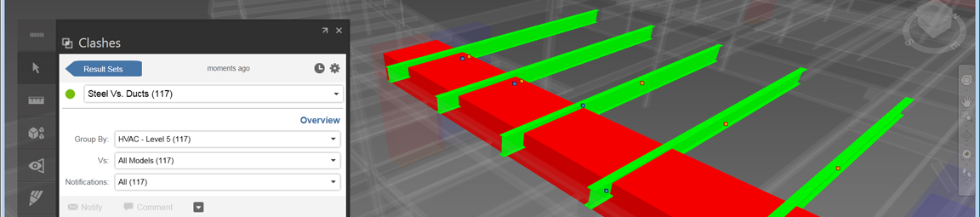
BIM 360 Glue: Oparte na chmurze narzędzie BIM do zarządzania i współpracy
Dostęp zawsze i wszędzie
Zgłoszenia problemów i współpraca
Wykrywanie kolizji
Mobilność
Notes:
We start with inviting a new user into our project so they can access the project models from anywhere anytime.

Slide 31
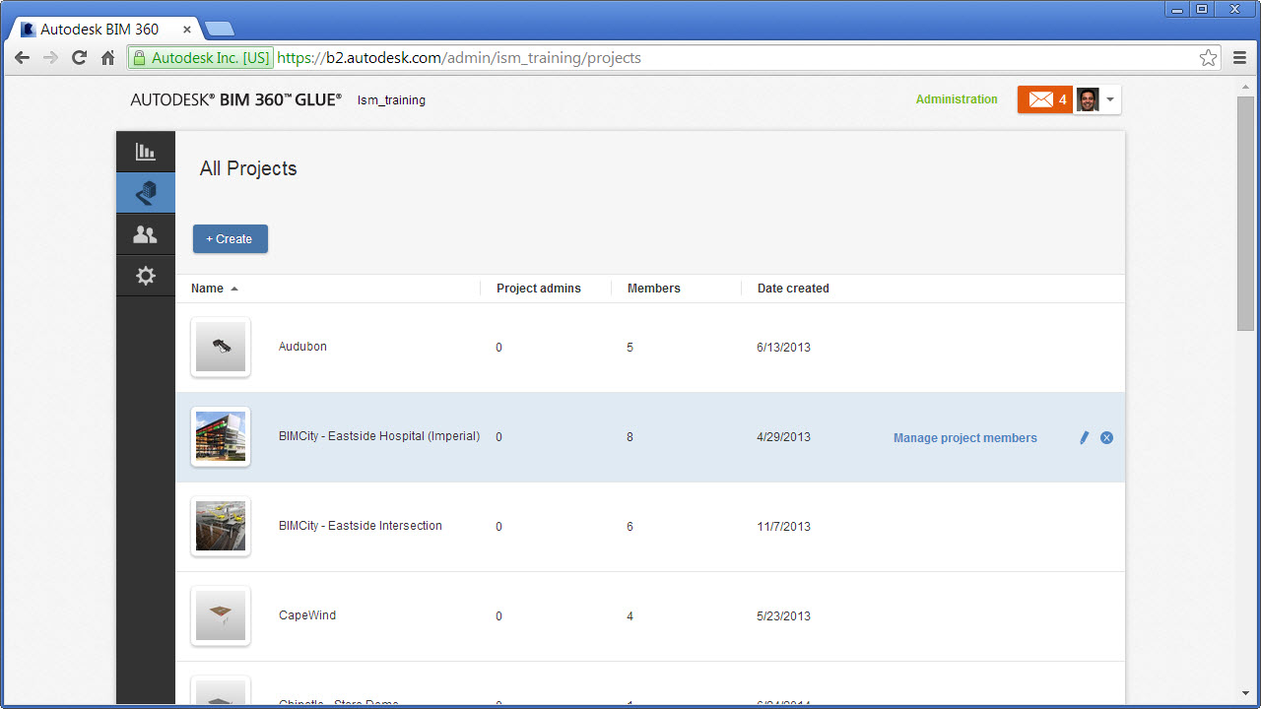
Oparte na sieci administrowanie projektu.
Notes:
We’ll begin by managing our project using the BIM 360 Glue web based project Administration console. This enables access to our projects and users management from any browser via the web, so we can control and manage the access to our projects anytime. We’ll invite a new member to our Hospital project from here.
Here we have the list of current project members that are part of our extended construction team. We can add, edit and view the users as well as view statistics about their access and status within the project. Let’s add a new user, Deb Miller to the project so she can manage the HVAC project information.
Here we can simply select from an existing set of user form our host, who have worked on other projects with us in Glue, or add a new user by entering their Email. The system automatically notifies them they are invited to the project, and grants them access via a simple Email.

Slide 32
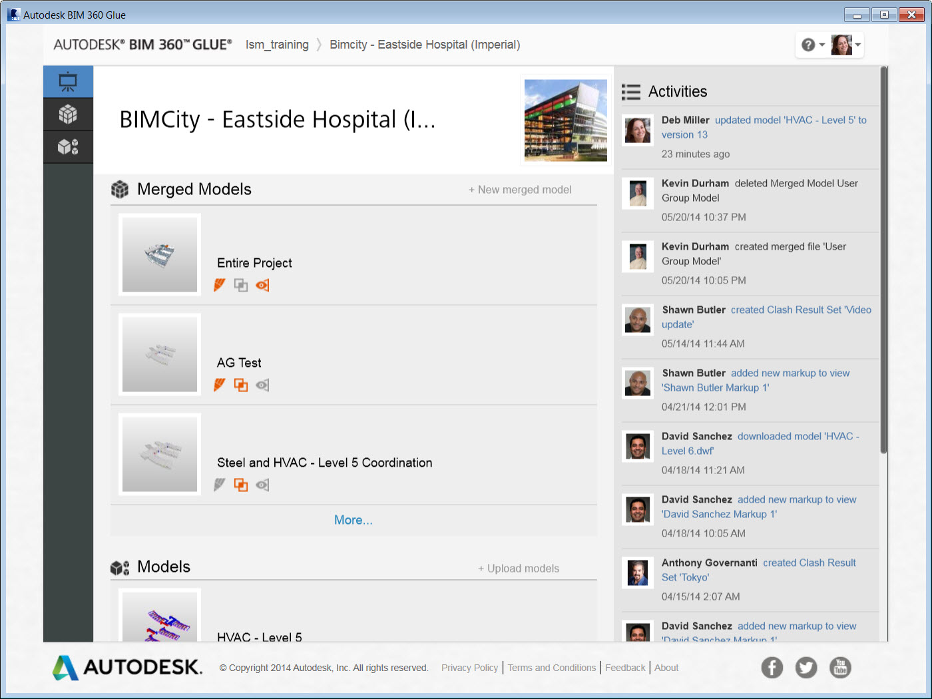
Notes:
Deb can now dig into the project, and see even more detail, such as the latest merged models, as well as an activity stream here on the right. This stream communicates the latest actions that are tracked by Glue in our project. Let’s say that Deb wishes to start uploading the HVAC models she is managing.
There are two ways for a user to add model information to the project; manual upload and from within an Autodesk application. Here we see the manual upload, where Deb has selected to browse her local computer to find a file to upload. She can also simply drag and drop a file to the upload dialog. Note that when she browses, there is an opportunity to select from over 50 + file types that BIM 360 Glue supports.

Slide 33
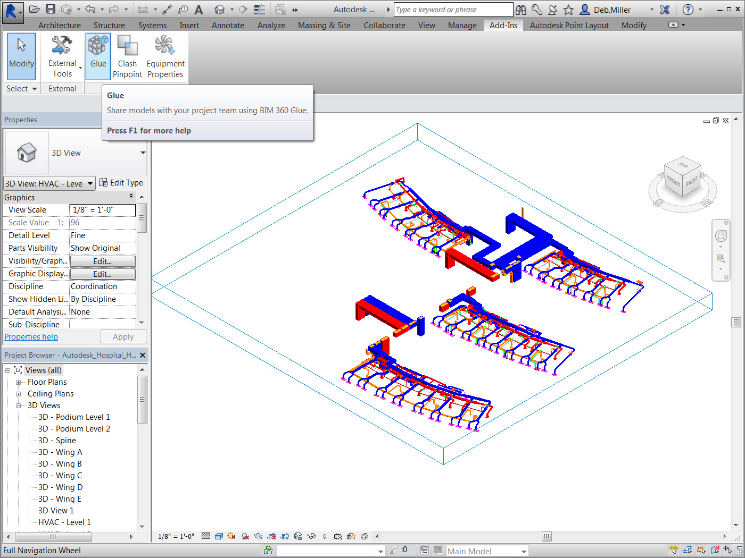
Notes:
We’ll now explore the process for uploaded files from within an Autodesk application. Here we have Autodesk Revit, which automatically installs with the BIM 360 Glue add-in. This enables us to glue our model views directly to the project, right here inside Revit.
We simply select a view from within the Revit Model, and Glue does all the heavy lifting. Glue packages up the model information, both the graphics and all the BIM parameters, and uploads them to the project for us.
We simply select a view from within the Revit Model, and Glue does all the heavy lifting. Glue packages up the model information, both the graphics and all the BIM parameters, and uploads them to the project for us.

Slide 34
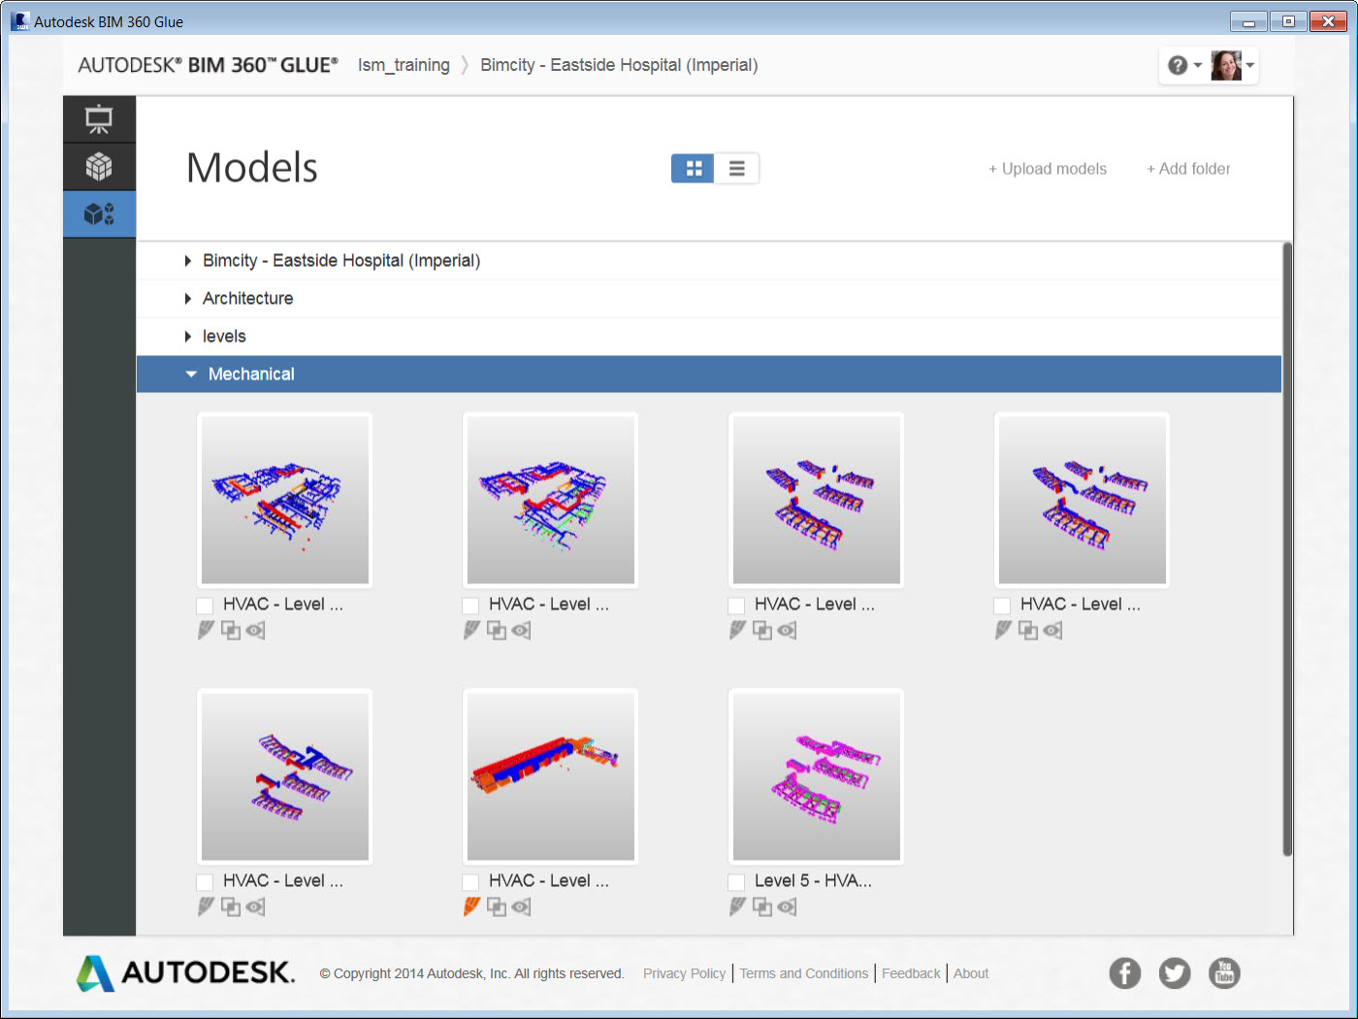
Notes:
As we move forward in time a little we see that all of the HVAC models are now Glued to our project, and that Deb can begin to manage them for her needs within Glue. The next step is to merge these models with other disciplines in the project so she can collaborate and coordinate with the other project stakeholders.

Slide 35
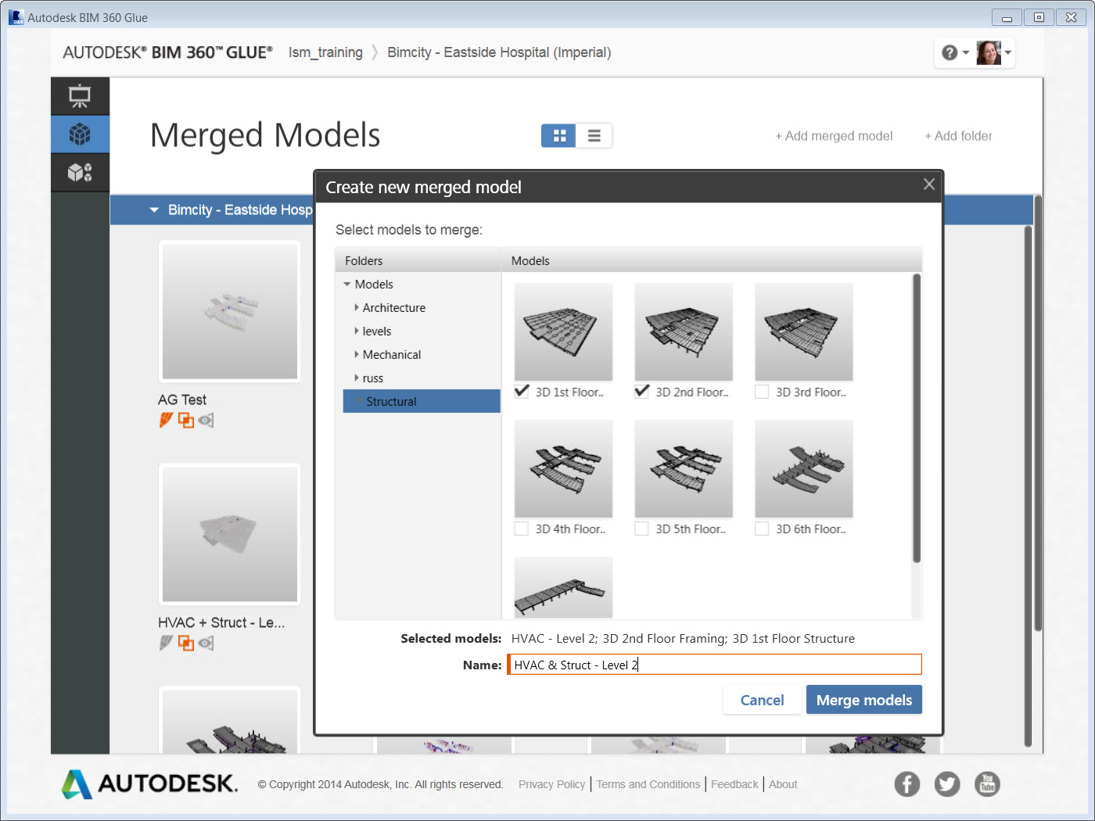
Notes:
Deb can quickly create an aggregated model for collaboration purposes by selecting the models she needs, and then Merging them into a single model. Here she is taking the level 2 & 3 structures and merging them with the Level 2 HVAC mode she has recently uploaded. The point here is that she can do this for the purposes she needs, instead of having to wait for a BIM manager or central coordination manager to compile the latest version of the models and then share with the team. Instead, she can create the aggregated models she needs on the fly, and because Glue is always working from one-shared Model, she is always has the latest information.

Slide 36
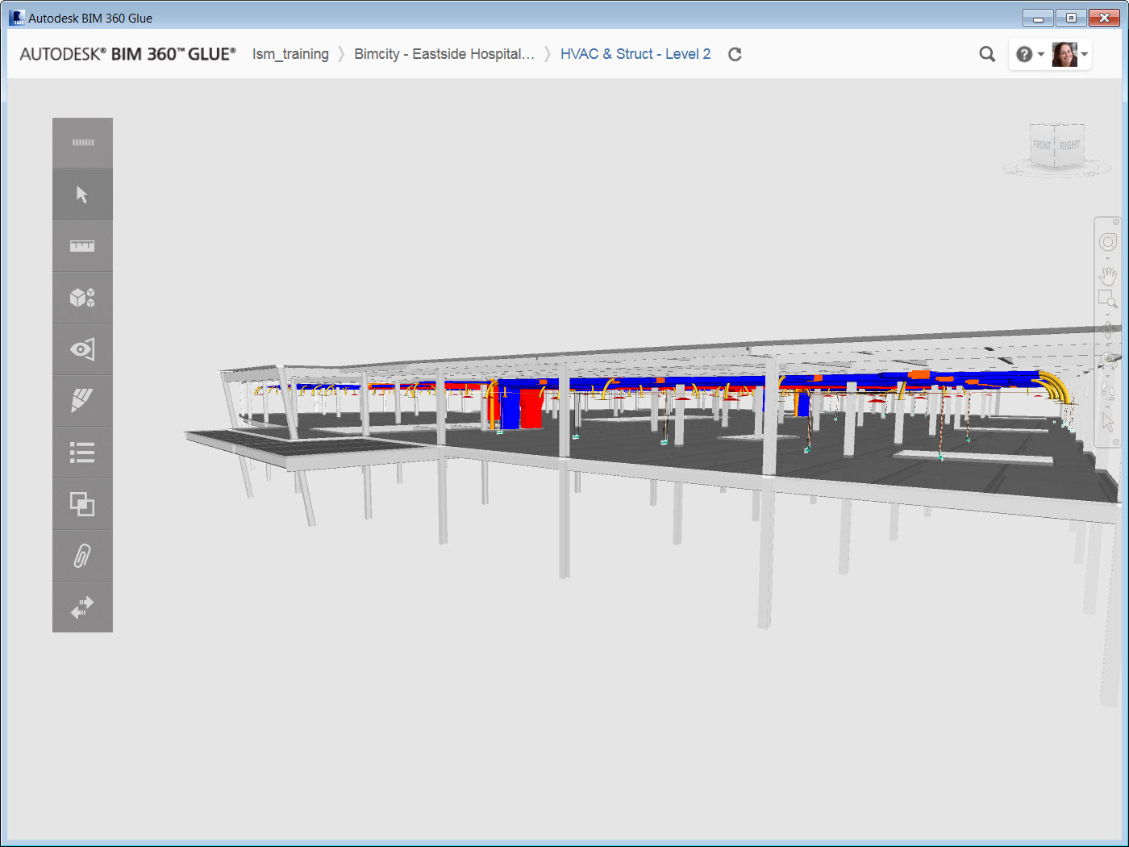
Notes:
Here we see that merged model, and we are ready to begin the collaboration and coordination process.

Slide 37
BIM 360 Glue: Oparte na chmurze narzędzie BIM do zarządzania i współpracy
Dostęp zawsze i wszędzie
Zgłoszenia problemów i współpraca
Wykrywanie kolizji
Mobilność
Notes:
We will now look at how to manage the notification and collaboration process within BIM 360 Glue with our extended team members.

Slide 38
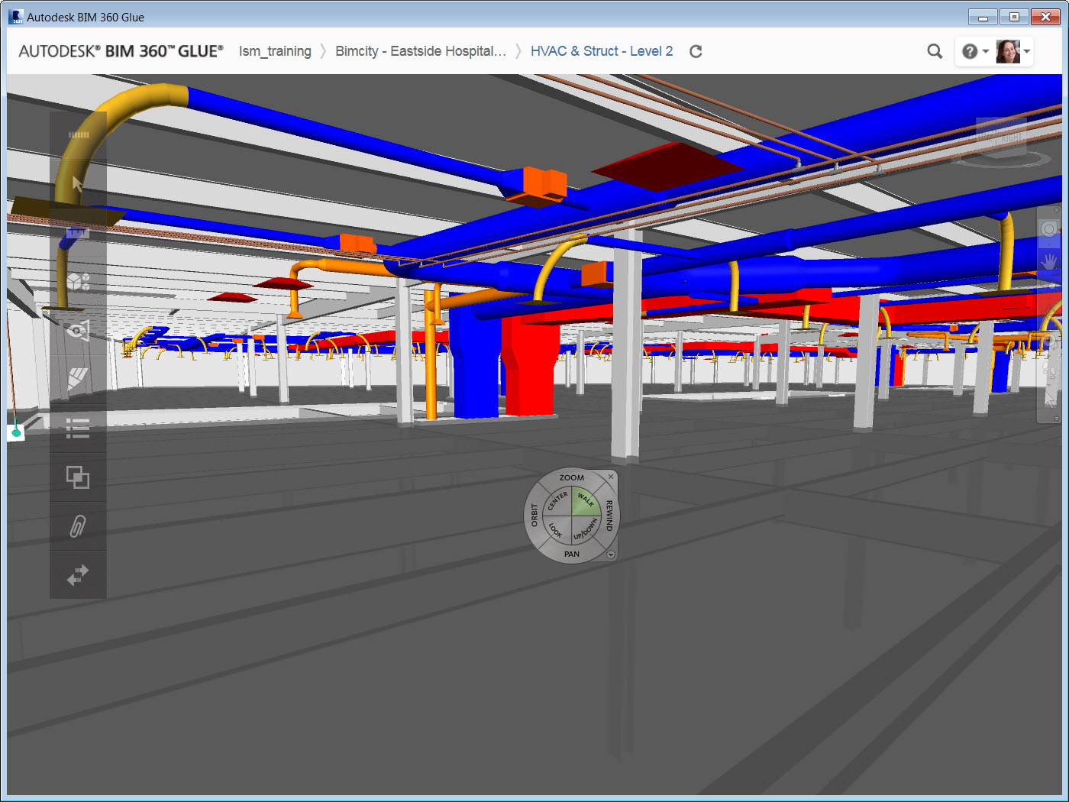
Notes:
BIM 360 Glue offers a straightforward system for navigating and interacting with our aggregated models. We have zoom, pan, orbit and walk navigation that makes it easy to explore our models.
As we explore our models, we can start to do some visual coordination. Here we can see there is a Round Duct that is coming up through the structural floor, but there isn’t an opening in the model to account for it. We can quickly mark this up, and send to the team for consideration.

Slide 39
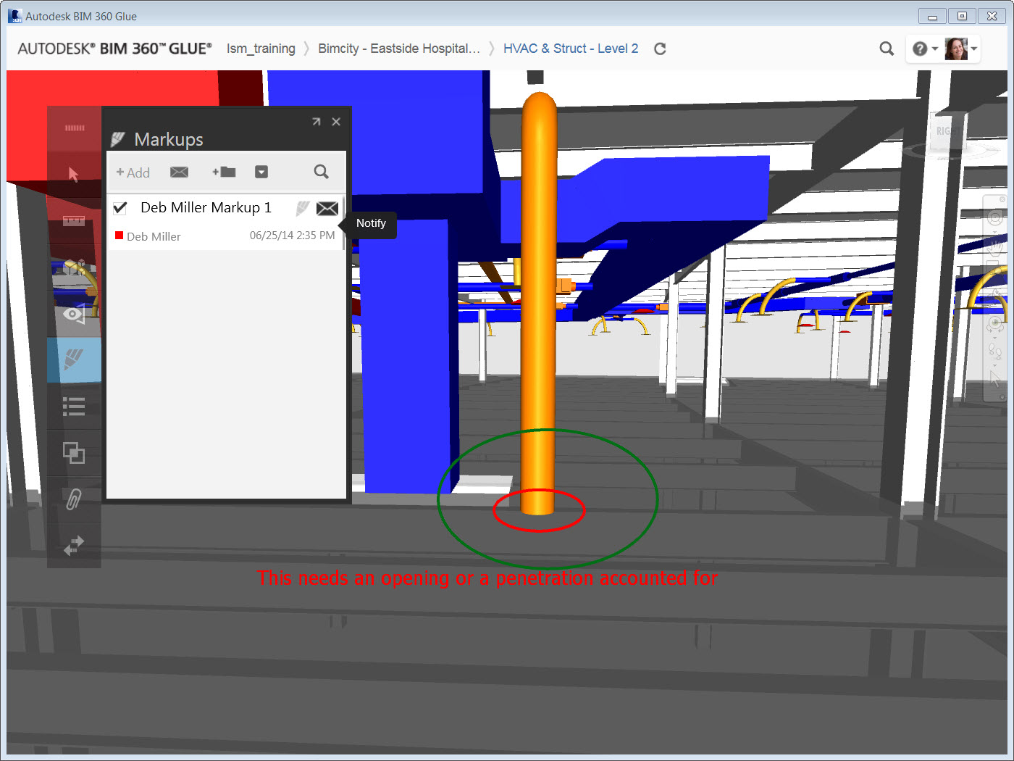
Notes:
Deb can use the markup capabilities of Glue to add detail to the current view about the issue she has seen. When she saves this markup, it is now captured as an activity in the projects, and the entire team can see it.
Not only is it saved for all to see, but she can explicitly share this markup via a notification.

Slide 40
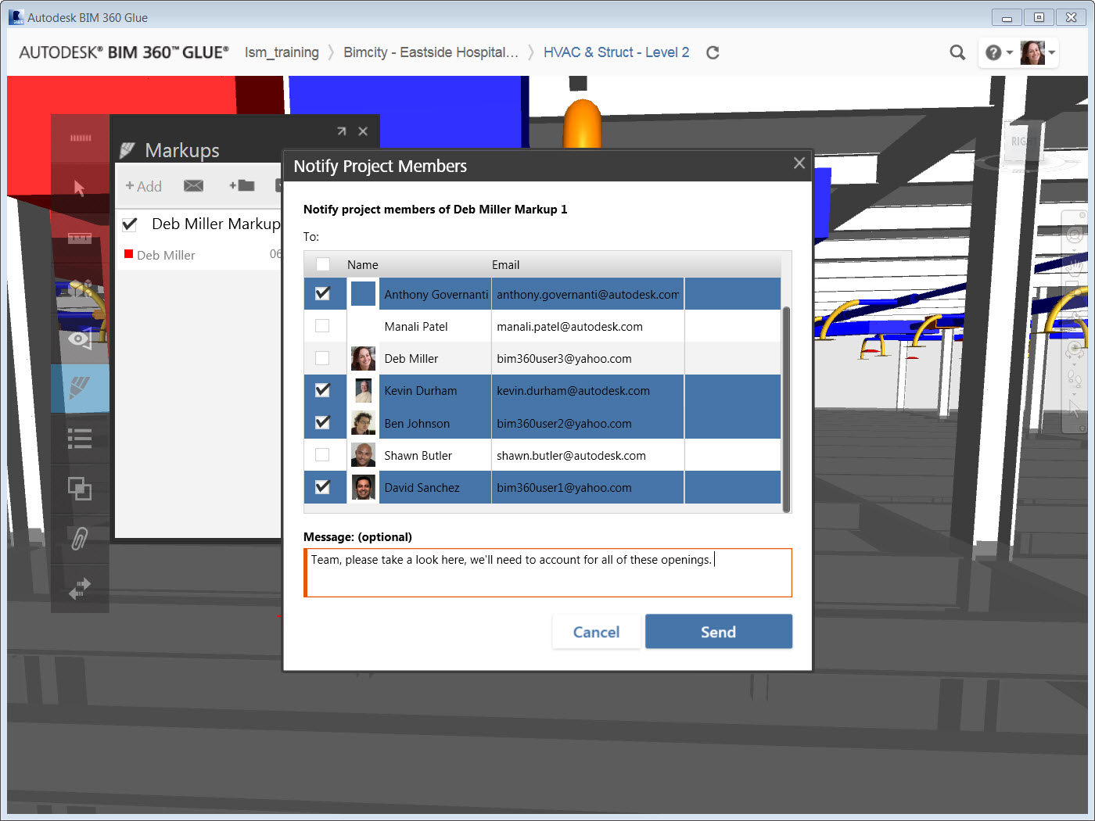
Notes:
The notification system built into Glue allows Deb to select the team members she wishes to collaborate with, type out a personalized note, and send an email to them all in one simple step. Once she is done, she can go back to her task of visual coordination, without ever stopping her process here in Glue. The result is time saved in sharing information with key project stakeholders, and ensuring ust the team members needed are communicated with securely and efficiently.

Slide 41
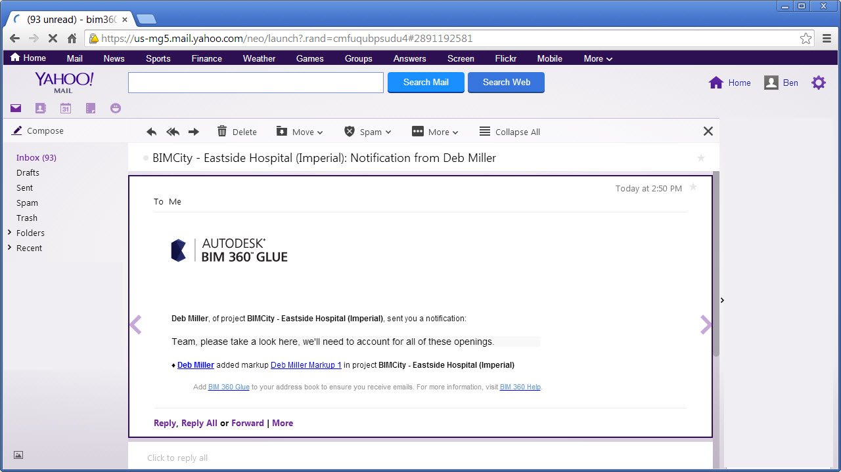
Notifications
Notes:
To further demonstrate the power of this Collaboration, we’ll switch our perspective to one of the other team members, Ben Johnson.

Slide 42

One-Click to BIM
Notes:
All Ben needs to do in order to view the model and markup that Deb just shared with him is to select the Hyperlink within the email that Glue sent him. Glue will do all the heavy lifting again, in that it will automatically launch, will load the exact model and version that contains the markup, and take Ben directly to the markup.

Slide 43

Notes:
Note we are now logged in as Ben, and Glue Automatically took him to that markup. No need to download models from an FTP site, or from email, no need to hunt and search for the right markup or viewpoint; he is right where he needs to be to see the information Deb shared with him, and can take action immediately. Furthermore, if Ben wishes to markup and collaborate back with Deb, it’s just as easy.

Slide 44

Notes:
Ben can either add his own brand new markup, or better still, can append to Deb’s and add any detail he wants. Here he added a note that it was a great catch, and that he’ll manage through the layout process. This again is saved as activity in the project, and automatically seen by all on the team. He can again choose to notify explicitly, or just continue to work with the aggregated model and collaborate within Glue. It is important to note this system of collaboration that is inherent to how Glue works. We’ll rely on this collaboration throughout our entire Pre-construction coordination process to reduce the time it takes to share information, to perform clash detection, and to communicate our construction intent with the extended team.

Slide 45
BIM 360 Glue: Oparte na chmurze narzędzie BIM do zarządzania i współpracy
Dostęp zawsze i wszędzie
Zgłoszenia problemów i współpraca
Wykrywanie kolizji
Mobilność
Notes:
Moving ahead, we’ll now see how to use BIM 360 Glue for real-time clash analysis and coordination.

Slide 46

Notes:
Clash Detection is inherent in any model based coordination process today. The challenge with the traditional methods for performing this clash detection is that its often done in silos of effort, with team members isolated on their own versions of models. This makes it very challenging to ensure that the team is working consistently, and that they can quickly find and manage clashes within the project. Glue solves these challenges by moving that analysis to the cloud, and leveraging one centralized model with real-time clash. Let’s see it in action by first creating result set in an aggregated model.

Slide 47

Notes:
Here, Ben has the option of selecting the model elements he wishes to clash. For the coordination of the HVAC and Steel, we’ll start by selecting all of the Ducts, and then compare them to the framing and columns. Note we can set a tolerance for the comparison too. From there it’s a simple matter of naming the clash, and Finding them.
Again, BIM 360 Glue does the hard work leveraging the cloud, and processes a real-time clash test.

Slide 48

Notes:
Quickly the results are returned to Ben, and he can begin to analyze the clashes found, for this model, 122 of them. We see that Glue shows an overview of the results, with a graph showing a detailed breakdown of how each model in the test compares. It also highlights all of the clashes found on the model for is in the form a markers. Each marker represents a clash spatially, so we can quickly understand the context of our results.

Slide 49

Notes:
We can now accelerate our project review specific to these two disciplines. We see the conflicts we have on this level, and then filter on the results to best understand the issues found by grouping the results by model, for example Ben would like to see how the HVAC compares specifically to the 6th floor structure.

Slide 50

Notes:
Grouping the clash this way we can see what ducts have multiple structure elements clashing with it. this is powerful in that Glue automatically does this grouping for us, and we can see that a major clash is happening with this duct, in fact it interferes with 5 pieces of the framing.
Glue also eases the management of these clashes by adding comments to each clash grouping. This makes it easy to track the status and further communicate intended actions with the conflicts. Once we have the results grouped as we need them, its time to share and collaborate on the results to find resolution.

Slide 51

Notes:
We’ll use the same built in notification system we used earlier with markups, and send out an email to the key project team members that will be involved in managing and resolving this conflict. Glue also takes real-time clashing a step further, in that we can filter right in the interface for these clash notification, and quickly see just the conflicts we need to deal with now. We see here that Ben has sent notifications to the team on the 5 clashes with the rectangular duct. Any team member that was notified is currently viewing this model will also be able to

Slide 52

Notes:
We see here that Ben has sent notifications to the team on the 5 clashes with the rectangular duct. Any team member that was notified is currently viewing this model will also be able to use this filter to see just the results that have been sent to them. Again this greatly streamlines the conflict management and resolution process, giving the team members real-time access to critical clash information. Deb can now take action in the appropriate design software to modify the models, and make updates. Let’s take a quick look at that process using Autodesk Revit.

Slide 53

Notes:
Here we are with Deb again, and she has the Revit HVAC construction model open, and is about to use the BIM 360 Glue add-in for Revit to see the clash results Ben just shared.

Slide 54

Notes:
The Clash Pinpoint option let’s Deb see all of the results that are shared to her, and we have the latest test from Ben at the top of the list. She’ll select it to view the details.

Slide 55

Notes:
Deb can see the 5 results that were grouped together in Glue and sent to her for resolution. Using the View Selected button, Deb can quickly isolate the conflicting duct, and take action.
She can toggle back and forth from isolating the clashes to viewing the entire model again to ensure the action taken is resolving the issue. With this duct dropped to avoid the framing, she can Glue the updates back to the project and move onto the next conflict in the list.

Slide 56

Notes:
Glue prompts Deb to update the existing model, which she will do since she has adjusted the conflict. We can then switch back to Glue and see the results.

Slide 57

Notes:
Ben is still working away with the aggregated model, when he is instantly notified that a change to the model has happened.

Slide 58

Notes:
We see the result set is also letting Ben know there is an update since it was last run. Ben can re test the clashes, and see that the 5 conflicts with the rectangular duct have been resolved.

Slide 59

Notes:
Glue has empowered our multidiscipline teams to access the most recent project models, quickly find conflicts with real-time clashing, and resolve the coordination issues efficiently.

Slide 60
BIM 360 Glue: Oparte na chmurze narzędzie BIM do zarządzania i współpracy
Dostęp zawsze i wszędzie
Zgłoszenia problemów i współpraca
Wykrywanie kolizji
Mobilność
Notes:
We’ll now see how to take all the valuable BIM coordination and collaboration information for our project out to the field via a mobile application on the iPad using BIM 360 Glue.

Slide 61

Notes:
Often times there is a need to share the information in our models with stakeholders who either aren’t directly involved in the coordination process, like field personnel, or just need progress checks, like an owner or project manager. This is where mobility can play a key role in extending the value of a coordinated model to these consumers. We will start the process by sharing a view in our project with a reviewer role assigned to Anthony.

Slide 62

Notes:
We will move the iPad now, and show a workflow for consuming and interacting with the coordination models out in the field. Here we see the pop-up notification for the view that Ben just shared with our new user, Anthony.

Slide 63

Notes:
Just like the desktop app, here we are brought directly to the correct model and the view shared with us is loaded, streamlining the collaboration process with the mobile user. From here, Anthony can interact with the model using straightforward navigation.

Slide 64

Notes:
Anthony can use the joystick to walk around the model, as well as gestures for zoom, pan, and orbit.

Slide 65

Notes:
The mobile app also has tools for measurement, where we can verify model dimensions while we are in the field. Here, Anthony is using the point-to-point measure tool, and can even press and hold to magnify a location and snap to the point he needs.

Slide 66

Notes:
The Glue mobile app then displays a dimension for him, even showing the x, y, and z differences.

Slide 67

Notes:
He can even select two model elements and get the minimum distance displayed between the them. All in all, some very simple yet powerful measurement tools, right at his fingertips. Measurement isn’t all though, Anthony can also view and create markups just like his teammates can in the desktop app.

Slide 68

Notes:
Here is the markups toolbar, showing everything that has been created and shared with the team for this model. Anthony can simply select any of these to see the markup he needs, or he can create his own.

Slide 69

Notes:
Drawing shapes and freehand lines is the same as the desktop interface, made even easier with gestures on the iPad. Adding text to clearly communicate the intent is also simple, and then Anthony can share this markup for the team to see.

Slide 70

Notes:
Notification is easy too, with glue again doing the heavy lifting of emailing the details of the markup via a hyperlink with Anthony’s message, all right inside the app.

Slide 71

Notes:
As we saw on the desktop app, this isn’t just a 3D model, but a full BIM with all of the parameters for us to explore and navigate. The Autodesk BIM 360 Glue mobile app connects the entire project team and streamlines BIM project review and coordination workflows.

Slide 72
FIELD

Slide 73

BIM 360 Field: Aplikacja na Ipad’a
Możliwość przeglądania dokumentacji projektowej
Wypełnianie formularzy kontrolnych i fotodokumentacja problemów
Adnotacje, chmurki rewizyjne na bieżąco, na dokumentacji.
Zamykanie problemów i komentowanie rzeczy pozostałych do zrobienia
Lista czynności do wykonania
Zarządzanie instalacją i uruchomieniem urządzeń (wyposażenia)
Dokumentacja do odbiorów inwestycji i późniejszej eksploatacji
Notes:
We are going to start with that iPad in the field by taking a look at viewing construction documents within BIM 360 Field.

Slide 74








Notes:
Here we are on the iPad, working in an offline or disconnected mode where you can work locally without the need to be connected to Wifi or Cell service to access the project data.
We simply browse the library of documents; select the folder needed, then select the drawing to view it.
An important feature of using BIM 360 Field is that you synchronize with the database and choose just the files you want/need in the field. This helps provide you with the right versions of the data at the right time

Slide 75
Notes:
We can pan and zoom around this document as needed, very quickly and efficiently. Note that the BIM 360 Field website is the place that hosts all the data, but on the iPad you can have contextual information. This means that you only need to have the data you care about for a specific action, activity, day or set of tasks you are specifically working on; making the system faster and more efficient for your needs now.

Slide 76
Notes:
Using straightforward navigation, I can quickly explore the documents I need and get to the detail from my tasks. Here I am working with multiple sheets, and I can easily move from one to another and pan and zoom as needed, right on the iPad in the field where the work is being done.

Slide 77
Notes:
Plans aren't the only documents I have available either. Any file type can be synchronized from the library, and opened here in the field. Here we have an installation specification for a water pump.

Slide 78
Notes:
Again I can quickly view the document details, browse to the page needed, and pan and zoom to get to the detailed information quickly.

Slide 79
Notes:
BIM 360 Field provides ultimate flexibility when managing documents in the field, in that I can have just the information needed for a given task, work in an offline or disconnected mode, and quickly access that information with straightforward navigation on the iPad.

Slide 80
BIM 360 Field: Aplikacja na Ipad’a
Możliwość przeglądania dokumentacji projektowej
Wypełnianie formularzy kontrolnych i fotodokumentacja problemów
Adnotacje, chmurki rewizyjne na bieżąco, na dokumentacji.
Zamykanie problemów i komentowanie rzeczy pozostałych do zrobienia
Lista czynności do wykonania
Zarządzanie instalacją i uruchomieniem urządzeń (wyposażenia)
Dokumentacja do odbiorów inwestycji i późniejszej eksploatacji
Notes:
Next we will complete a quality inspection.

Slide 81

Notes:
We start with a set of templates for quality control checklists. These are either pulled from your company’s master library, imported from Excel®, or you can leverage our built in content. The point is that they can be configured by your project team and can be specific to the project, or in this case, a specific task like Above the Ceiling close-in.

Slide 82

Notes:
We simply work our way down the list, picking yes/no, true/false, pass/fail, or however the check list is configured for this specific activity.

Slide 83

Notes:
Note that for one of the items in the list, there is a little icon here above the Issue button, the blue “I”. It is a very powerful part of the workflow.

Slide 84

Notes:
The blue “I” is how the project team can provide information to the inspector about what the installation should look like so they can confirm whether the observation is in or out of conformance. A Specification, a photo of what a conforming install looks like, other supporting documents; they all can be attached to the checklist item to enable easy access to valuable inspection data.

Slide 85

Notes:
Here we can see the specification for the plumbing installation displayed, with a specification denoting how the insulation is supposed to be installed. Having this data at the inspectors fingertip helps you and your project team establish a standard of conformance for this and all observations moving forward.

Slide 86

Notes:
Before we mark this as non-conforming, I will add a comment as to why it is out of conformance.

Slide 87

Notes:
Whenever we mark an item as non-conforming, it creates an issue in the database automatically. The issue will have a unique ID number, a type for following up on and reporting, a company it’s assigned to, a status and so on.

Slide 88

Notes:
All these fields are configured to have the information we need for our inspection tracking and reporting.

Slide 89

Notes:
The description for the issue is prepopulated with the text we need already, but we can also add comments and notes as needed. We will also add attachments to the issue where we are given the choice to use the built in camera on the IPad to take a photo, or attach a drawing or document from the library.

Slide 90

Notes:
In this case, we’ll take a photo, and can markup that photo by drawing and highlighting details about the issue, tap out a caption, add text; whatever we need to communicate the issue details.

Slide 91

Notes:
We can also attach PDFs, before and after photos, or however many documents we need to more accurately and effectively communicate the issue.

Slide 92

Notes:
Once an inspection is complete, and I have filed out an entire checklist, I can close it out to ensure that the information is shared with the project team. Here we have an opportunity to sign off on the inspection as complete.

Slide 93

Notes:
We then close the checklist and move onto our next task. It is important to note that you don’t have to close a checklist if your inspection isn't done. it is automatically saved in its current state, and we can always come back to it later for re-inspection or to continue the process where left off.

Slide 94
BIM 360 Field: Aplikacja na Ipad’a
Możliwość przeglądania dokumentacji projektowej
Wypełnianie formularzy kontrolnych i fotodokumentacja problemów
Adnotacje, chmurki rewizyjne na bieżąco, na dokumentacji.
Zamykanie problemów i komentowanie rzeczy pozostałych do zrobienia
Lista czynności do wykonania
Zarządzanie instalacją i uruchomieniem urządzeń (wyposażenia)
Dokumentacja do odbiorów inwestycji i późniejszej eksploatacji
Notes:
Another way to capture issues in the field is to add pushpins to drawings.

Slide 95

Notes:
Another way to view our issues is by location. This allows us to see just the issues for a specific place or location within our project. Here we are filtering by floor level, and can even get to specific rooms as well.

Slide 96

Notes:
We can capture issues in the field by adding pushpins to plans. Here we can see several issues in Room 302 on the 3rd floor. Note the different colors for the pins that denote the different statuses for the issues. This is powerful for our subs and trades, in that they can see this same information for their issues, and can quickly see if they have an area of the project that needs immediate attention i.e. a lot of red pins (open status). This is equivalent to me taking a paper drawing out to the field, and just making notes and markups where I see issues. Here we take the digital drawing, browse to the area in question, panning and zooming as needed with straightforward navigation, and drop pushpins on the area of the issue.

Slide 97

Notes:
I can also add a new issue here on the plan by dropping a new pin in the appropriate location. I will use the Issue templates to do this (rubber stamp), which uses my company standards for issue types, and will note a non-conformance for drywall in this room.

Slide 98

Notes:
Note that a lot of the information I need for this issue is already populated, this saves time when adding the same issue multiple times, and ensures a consistency across all of my inspections. No matter where or when I find a non-conformance like this hole in the drywall, I am always capturing the same data.

Slide 99

Notes:
While I am here, I can also attach more detail to the issue, in this case, take a picture of the problem using the built in camera on the ipad.

Slide 100

Notes:
Using the simple but powerful markup tools, I add additional detail, denoting where the problem area is within the photo. I can also add text or captions to further communicate all the information I wish the sub or specialty trade to see in order to comply or fix the problem.

Slide 101

Notes:
If we find a problem while walking the site that isn't part of a inspection, I can simply click the plus sign from the issues list, and add another one as needed. This gives me a blank issue that I can fill all the details in for. This is useful for when you find a problem on site that doesn’t fit into the typical situation that our issue templates cover.

Slide 102

Notes:
I simply click down through the issue, adding the information needed such as company, status, types etc. I can also add a description and comment that will be seen by anyone who works with this issue.

Slide 103
BIM 360 Field: Aplikacja na Ipad’a
Możliwość przeglądania dokumentacji projektowej
Wypełnianie formularzy kontrolnych i fotodokumentacja problemów
Adnotacje, chmurki rewizyjne na bieżąco, na dokumentacji.
Zamykanie problemów i komentowanie rzeczy pozostałych do zrobienia
Lista czynności do wykonania
Zarządzanie instalacją i uruchomieniem urządzeń (wyposażenia)
Dokumentacja do odbiorów inwestycji i późniejszej eksploatacji
Notes:
As we move forward in time a bit, let’s now discuss how to close out completed items or comment on work left to finish using BIM 360 Field.

Slide 104

Notes:
Working as if I had a notebook and pen to track items that need to be followed up on, I can view and work with a list of all the issues on my project. Here I can see the name, description, status, as well as the company the issue is assigned to for action.

Slide 105

Notes:
I can dig into the details of any issue easily, in this case, looking at the comments that have been added for this pipe insulation issue. If need be, I can add my own comment to the string and quickly move on.

Slide 106

Notes:
Just like when we created an issue from a checklist, I can also see any attachments to this issue from the list. In this case we have both a plan denoting where the issue is located, as well as a photo communicating more detail about that issue with a markup.

Slide 107

Notes:
Another advantage Field delivers is the ability to quickly filter the list of issues to find exactly what is needed.

Slide 108

Notes:
We will filter our current list by status, and show just the issues that are ready to inspect.

Slide 109

Notes:
We now have a list of just the issues that are ready to inspect, and can continue with our tasks from here by simply adjusting the statuses on screen, or by selecting an issue and digging into the details as needed. The point is, we are quickly and effectively closing work that is left to be done or completing work from previous inspections.

Slide 110
BIM 360 Field: Aplikacja na Ipad’a
Możliwość przeglądania dokumentacji projektowej
Wypełnianie formularzy kontrolnych i fotodokumentacja problemów
Adnotacje, chmurki rewizyjne na bieżąco, na dokumentacji.
Zamykanie problemów i komentowanie rzeczy pozostałych do zrobienia
Lista czynności do wykonania
Zarządzanie instalacją i uruchomieniem urządzeń (wyposażenia)
Dokumentacja do odbiorów inwestycji i późniejszej eksploatacji
Notes:
Next, we will look at the task management capabilities of BIM 360 field.

Slide 111
BIM 360 Field: Aplikacja na Ipad’a
Możliwość przeglądania dokumentacji projektowej
Wypełnianie formularzy kontrolnych i fotodokumentacja problemów
Adnotacje, chmurki rewizyjne na bieżąco, na dokumentacji.
Zamykanie problemów i komentowanie rzeczy pozostałych do zrobienia
Lista czynności do wykonania
Zarządzanie instalacją i uruchomieniem urządzeń (wyposażenia)
Dokumentacja do odbiorów inwestycji i późniejszej eksploatacji
Notes:
Let’s now take a look at tracking the installing and startup of equipment using BIM 360 Field.

Slide 112





Skan kodu kreskowego w celu identyfikacji urządzenia
Notes:
Let’s say we have a pump in the field that we want to find out more information on.
CLICK
Here we see the RedLaser component on the IPad that enables us to scan 2d and 3d bar codes on equipment.
CLICK
The barcode attached to this particular piece of equipment makes the connection to the BIM 360 Field equipment database, and it brings us to all the information for the equipment when it is scanned, automatically. CLICK

Slide 113

Notes:
Here we see the equipment view on the iPad. We have all the fields your project team can configure for the equipment. Across the top of the view, we have the categories of items that can be managed with each piece of equipment; check lists, attachments, such as operating manuals, specifications and any other documents or information you need attached to the equipment to reference in the field. The important take away here is that the field personnel can get all the information they need. There is one person (a project administrator) that can add the data – a single source of truth. Lastly, we note that we can also view the equipment in a Model.

Slide 114

Notes:
This is where we see how we can extend the Field Management capabilities further with the use of Building Information Models or BIM. Here is the building model coming from Autodesk Navisworks Simulate or Manage, downloaded to the iPad where we can pan, zoom, walk and view the model however we need. The pump we were working with is highlighted in the mechanical room of our project, with the full information model available to interact with.

Slide 115

Notes:
While exploring the model here on the iPad, you can also make observations with push pins just like you had with a drawing before. Let’s say that while inspecting the pump, we notice a crack in the floor near the base.

Slide 116

Notes:
We can add comments to the issue and make sure it is assigned to the correct company to resolve. We then can connect this field information back to the model in Navisworks Simulate or Manage and see Field management information updating the model.

Slide 117
BIM 360 Field: Aplikacja na Ipad’a
Możliwość przeglądania dokumentacji projektowej
Wypełnianie formularzy kontrolnych i fotodokumentacja problemów
Adnotacje, chmurki rewizyjne na bieżąco, na dokumentacji.
Zamykanie problemów i komentowanie rzeczy pozostałych do zrobienia
Lista czynności do wykonania
Zarządzanie instalacją i uruchomieniem urządzeń (wyposażenia)
Dokumentacja do odbiorów inwestycji i późniejszej eksploatacji
Notes:
BIM 360 Field is a powerful tool for tracking and documenting commissioning data, let’s take a closer look.

Slide 118



BIM 360 Field: Commissioning
Duże prawdopodobieństwo zagubienia lub utraty
Czasochłonne przy wprowadzaniu danych
Łatwość wprowadzania danych
Cyfrowe dane
Notes:
There are many challenges with a paper based commissioning and handover process for building construction today. Often the plans, specs and documents needed for commissioning are un-organized and don’t provide a viable solution for handover to an owner for facility management. By moving to an all digital, BIM 360 Field based process, we can easily migrate the equipment and commissioning information for a project, to the owner, as well as capture the valuable knowledge and data our specialty trades and sub contractors provide during the process.

Slide 119

Notes:
We saw the ability to attach documents to our equipment earlier. This is valuable for tracking equipment information, but can also be leveraged for handover deliverables, such as operating manuals, warranty cards, and any other documents needed downstream during the facility management process.

Slide 120


Notes:
As we just saw, we connected a model to our equipment database, and used it for viewing and interacting with our project information. Field goes beyond just a pretty picture though, and enables users to connect that valuable Information that is the “I” in BIM to the commissioning process. It streamline the use of project data and models to enhance the workflow. For example, here we have a model being viewed and used on the iPad in Field to commission a water pump. We have added checklists, tracked Issues, added manuals and warranty information, and in near real-time, a user, perhaps the Facility Manager, working in BIM 360 Glue is consuming that same model and all of the important handover documentation and data collected in the field. This greatly increases the efficieny of the Handover process, while at the same time provides the contractor or GC doing the commissioning a new revenue stream with their owner.

Slide 121



BIM 360 Field: Interface z przeglądarki internetowej
Dostęp z przeglądarki internetowej
Dostęp do wszystkich narzędzi
Dostęp zależny od funkcji użytkownika
Bezpieczeństwo danych
Notes:
Finally let’s go over the BIM 360 Field website. This is where we have browser based access to all the data collected in the field on the iPad, with a full suite of capabilities to interact with and report on that data. The access is secure and role-based, so that all project stakeholders, weather Subs and Specialty trades, owners, Architects or GC’s can have access to the valuable project information anytime, from virtually anywhere.

Slide 122

BIM 360 Field: Strona startowa zarządzania projektem
Notes:
We have project specific dashboards that are defined by the individual user to show the data and analysis they need most often.

Slide 123

BIM 360 Field: Lista potencjalnych problemów
Notes:
We can view the issues for the project, can see all of the issues project wide, but also use filters to get to just the data we need quickly. We have an easy to use and navigate interface where we can view the lists and then at any time, dig into the details quickly.

Slide 124

BIM 360 Field: Otwórz lub zrób zestawienie PDF wraz z znacznikami problemów
Notes:
We also have reports that can be run showing pushpins for issues, all sorted as we need them. In this report things are grouped by a subcontractor, color coded by status, and include any attachments, photos and markups associated with the items being reported.

Slide 125

BIM 360 Field: Raporty wraz ze zdjęciami i innymi załącznkiami
Notes:
These reports are generated on a schedule, emailed or delivered to all who needed them on the project team, and can automatically display just the information specific to the user. Here we are seing an Issue List report by company, but this user only gets access to the issues for their company.

Slide 126

BIM 360 Field: Zarządzanie bazą danych urządzeń instalacyjnych
Notes:
The equipment database we saw earlier on the iPad is also available via the website, where again we can see a whole project view or use filters to get to just the components we need. We see the equipment names, serial numbers, install dates and so on.

Slide 127

BIM 360 Field: Exportowanie zestawień
Notes:
We can also export this valuable information to create an electronic handover deliverable for the owner as well.

Slide 128
Autodesk ® BIM 360 Plan

Slide 129

Wydajność w budownictwie nie nadąża za zmianami w gospodarce
Notes:
Simply stated, our industry is behind (when compared to other industries) and we need to catch-up. The graph below depicts the production output of US manufacturing from 1964 – 2000 as compared to US construction production.

Slide 130
Straty w procesie budowlanym
Oczekiwanie
25%
Informacje
akceptacje
materiały
wyposażenie i narzędzia
Niepotrzebne działania
13%
Niepotrzebne magazynowanie
12%
Powtórzenie pracy
8%
Manufacturing Waste = 26%
Source: Construction Industry Institute - CII

Slide 131

Jak tworzyć efektywne plany?

Slide 132

Jak to wygląda… tygodniowe planowanie pracy
Courtesy of DPR

Slide 133

Jak to wygląda…
Codzienne raportowanie
Notes:
133
POLL THE AUDIENCE
This is a daily standup on the project hospital site I worked on
It takes place where the work is being done standing up (to keep the meeting short)
This is where we understand what gone done and didn’t get done.
What are we going to re-plan our work as necessary
Do you do daily stand ups? Experience?

Slide 134
Planowanie produkcji przy wykorzystaniu BIM 360 Plan

Slide 135


®
Pre-construction
Construction Execution
Commissioning/Handover
The Autodesk® BIM 360TM Plan pomaga zwiększyć niezawodność planów pracy wykonawców budowlanych, zwiększyć zyski poprzez zmniejszenie ilości odpadów związanych z nadprodukcją, nadmiarem zapasów i powtarzaniem prac.
Notes:
High level:
We have extended the benefits of BIM 360 Glue, by exposing the collaborative project model to fuel our construction layout process---which increases productivity while helping our clients save money.

Slide 136
Korzyści z Autodesk BIM 360 Plan:
BIM 360 Plan pomaga zwiększyć zyski z projektu i niezawodność harmonogramów przy minimalizacji odpadów:
Zapewnienia niemal w czasie rzeczywistym i bardziej przejrzyście dostępu do planów produkcji i harmonogramów
Eliminuje ręczne wprowadzanie danych i konieczność cyklicznych aktualizacji w arkuszach kalkulacyjnych.
Zamiana ręcznego procesu wymiany i dystrybucji cyklicznych aktualizacji harmonogramów na proces mobilnej wymiany informacji.
Mniej czasu potrzebne na zarządzanie i aktalizowanie procesem planowania budowy, który można wykorzystać na efektywną pracę wykonawczą.
Notes:
Summary:
Field personnel have the most up to date information at the point of execution
Remove the “slack-in-the line” when prepping and transferring data between the office and the field
Issues collected in the field are easily managed in the coordinated model for immediate remedy by the project team
Highly visual, model-based interface for walking the jobsite and laying-out points

Slide 137
Przegląd funkcjonalności

Slide 138


Slide 139

Przegląd funkcjonalności BIM 360 Plan
Funkcjonalności The Autodesk BIM 360 Plan:
Serwis internetowy Szybkie wprowadzanie danych Wizualizacja planów Stan zaawansowania prac Wspólne planowanie Raporty
iPad App Praca Online and Offline: nie jest wymagany dostęp do internetu Prosty interfejs graficzny Łatwe wprowadzanie danych Synchronizacja: udostępnianie zmian reszcie zespołu.

Slide 140
Tworzenie harmonogramów prac

Slide 141






Tworzenie planu
2
Import szablonów
1
Aktywny formularz
3
Kopiowanie

Slide 142



Przeglądanie planu
1
Wysietlanie listy
2
Swimlane
3
Ilustracja graficzna

Slide 143


Aktualizacja planów
3a
wykonane
1
2
Otwarcie
Zobowiązania
4a
Niekompletne
4b
Aktualizacja
Głowna przyczyna

Slide 144

Aktualizacja planów – serwis internetowy
2
Ustawienie statusu
1
Wybór

Slide 145


Aktualizacja planów – urządzenia mobilne
1
Wybór

Slide 146

Aktualizacja planów – urządzenia mobilne
2
Ustawienie statusu
1
Select Activities

Slide 147
Dla kogo ?

Slide 148
Dla kogo jest BIM 360 Plan?
Wykonawcy budowlani
Dla firm z już zaadoptowanymi zwinnymi (lean) metodami zarządzania procesem budowlanym
Użytkownicy
  Zaopatrzeniowcy, PM, brygadziści, inżynierowie, kosztorysanci, koordynatorzy zwinnych metodologii (Lean)
  Decydenci

Slide 149
Dla kogo jest BIM 360 Plan?
Profil firmy
  Firmy używające już Autodesk BIM 360
  Zakres małych i średnich firm (SMB), używają już oprogramowania Autodesk.
Zaadoptowane zwinne metody zarządzania (Lean)
  Przynajmniej 1 projekt wdrożony z sukcesem

Slide 150
Narzędzia planowania produkcji
 | BIM 360 Plan online multi-user software | Paper sticky notes & planning boards | Excel desktop single-user software | Primavera desktop or online single-user software | vPlanner Client server single-user software
Easy to use | ☑ | ☑ | ☑ | ☒ | ☒
Sharing | ☑ | ☒ | ☒ | ☑ | ☑
Updating | ☑ | ☒ | ☒ | ☒ | ☑
Reporting | ☑ | ☒ | ☒ | ☑ | ☒
Scalable | ☑ | ☒ | ☒ | ☑ | ☒
Secure | ☑ | ☒ | ☒ | ☑ | ☒

Slide 151


